Slide 1

Mothers’ Union Banners
in Newcastle Diocese

Slide 2
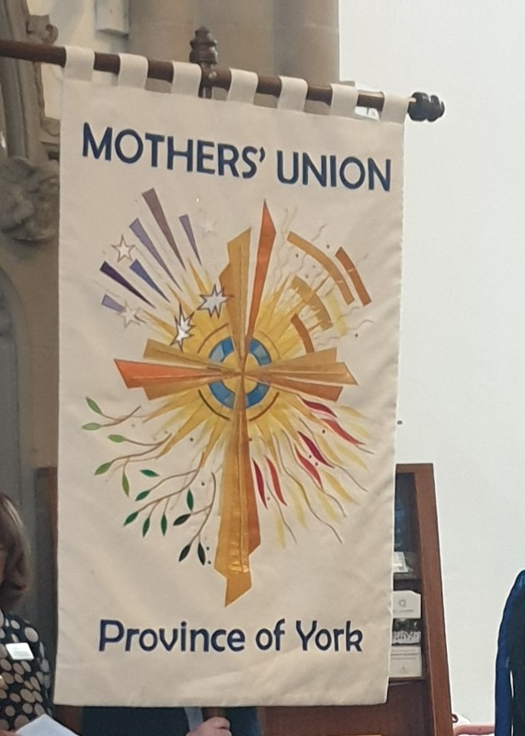
YORK PROVINCIAL BANNER

Slide 3
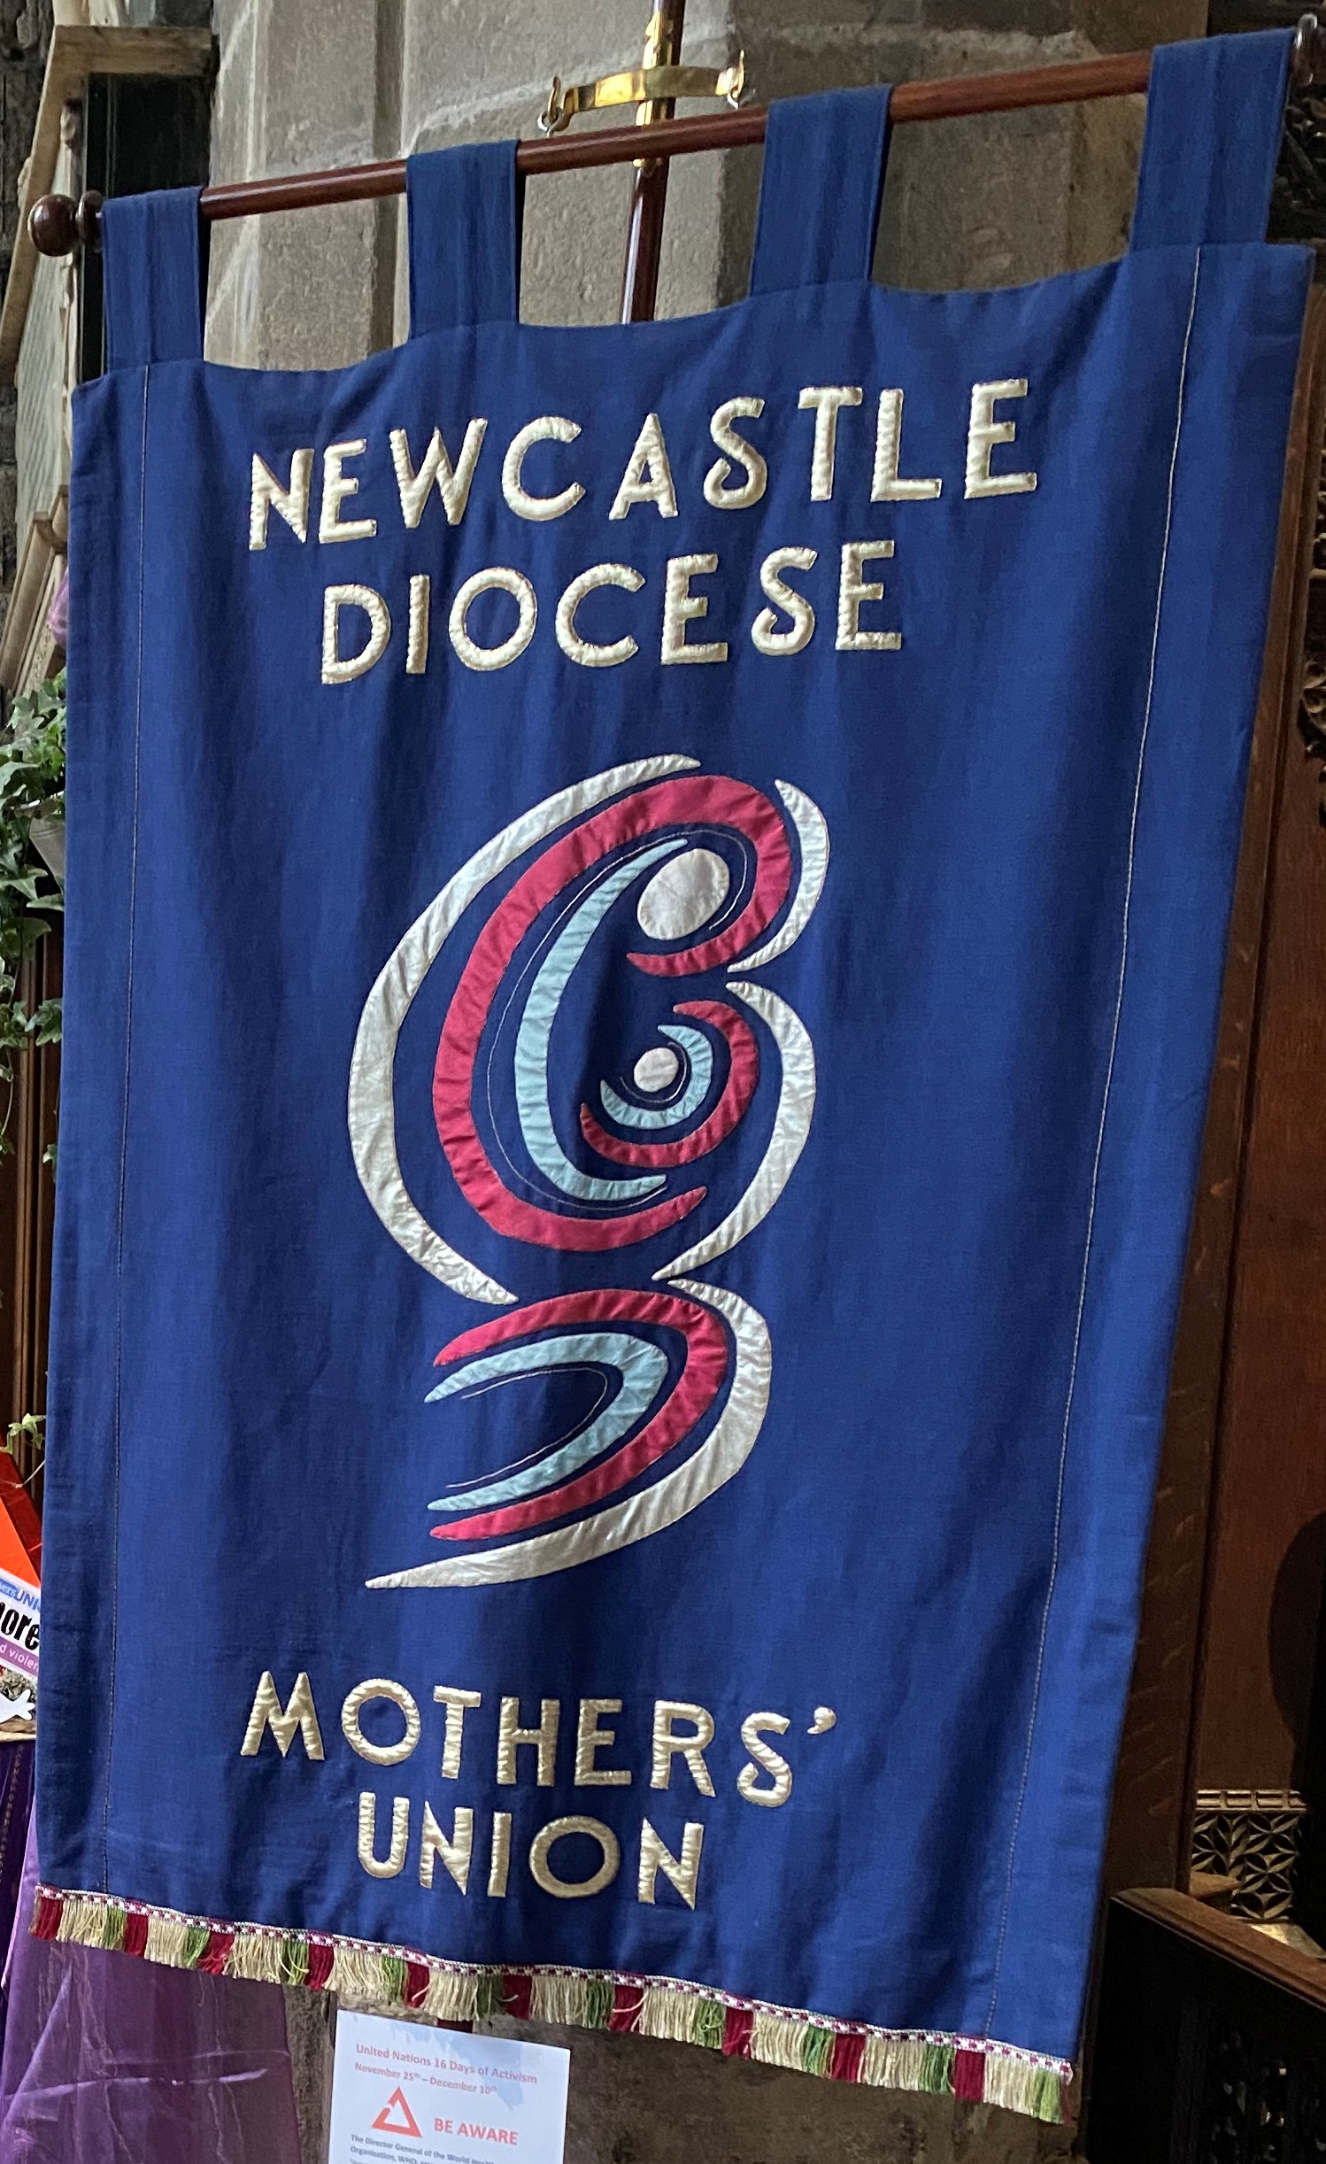
DIOCESAN BANNER

Slide 4
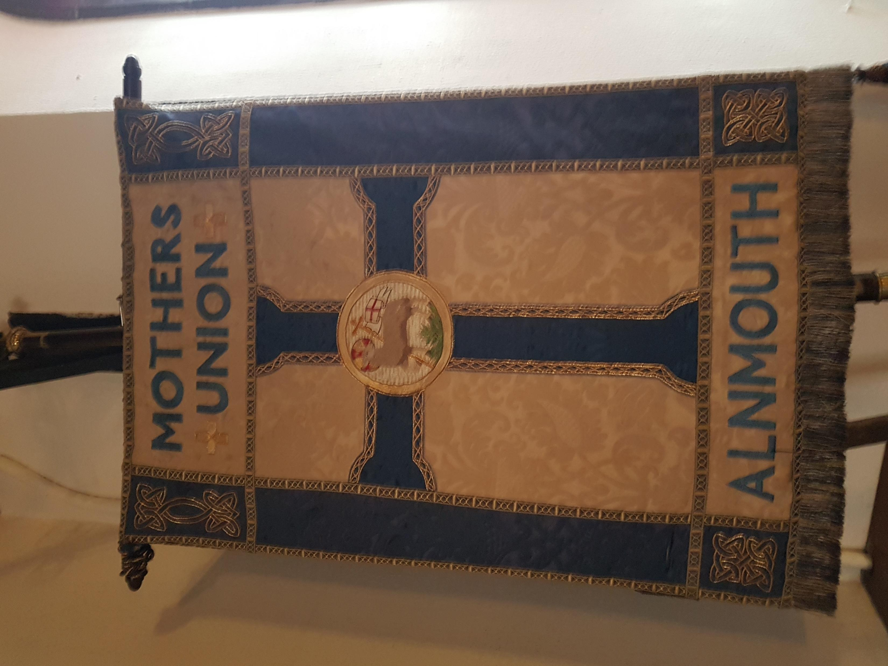
MU Alnmouth

Slide 5
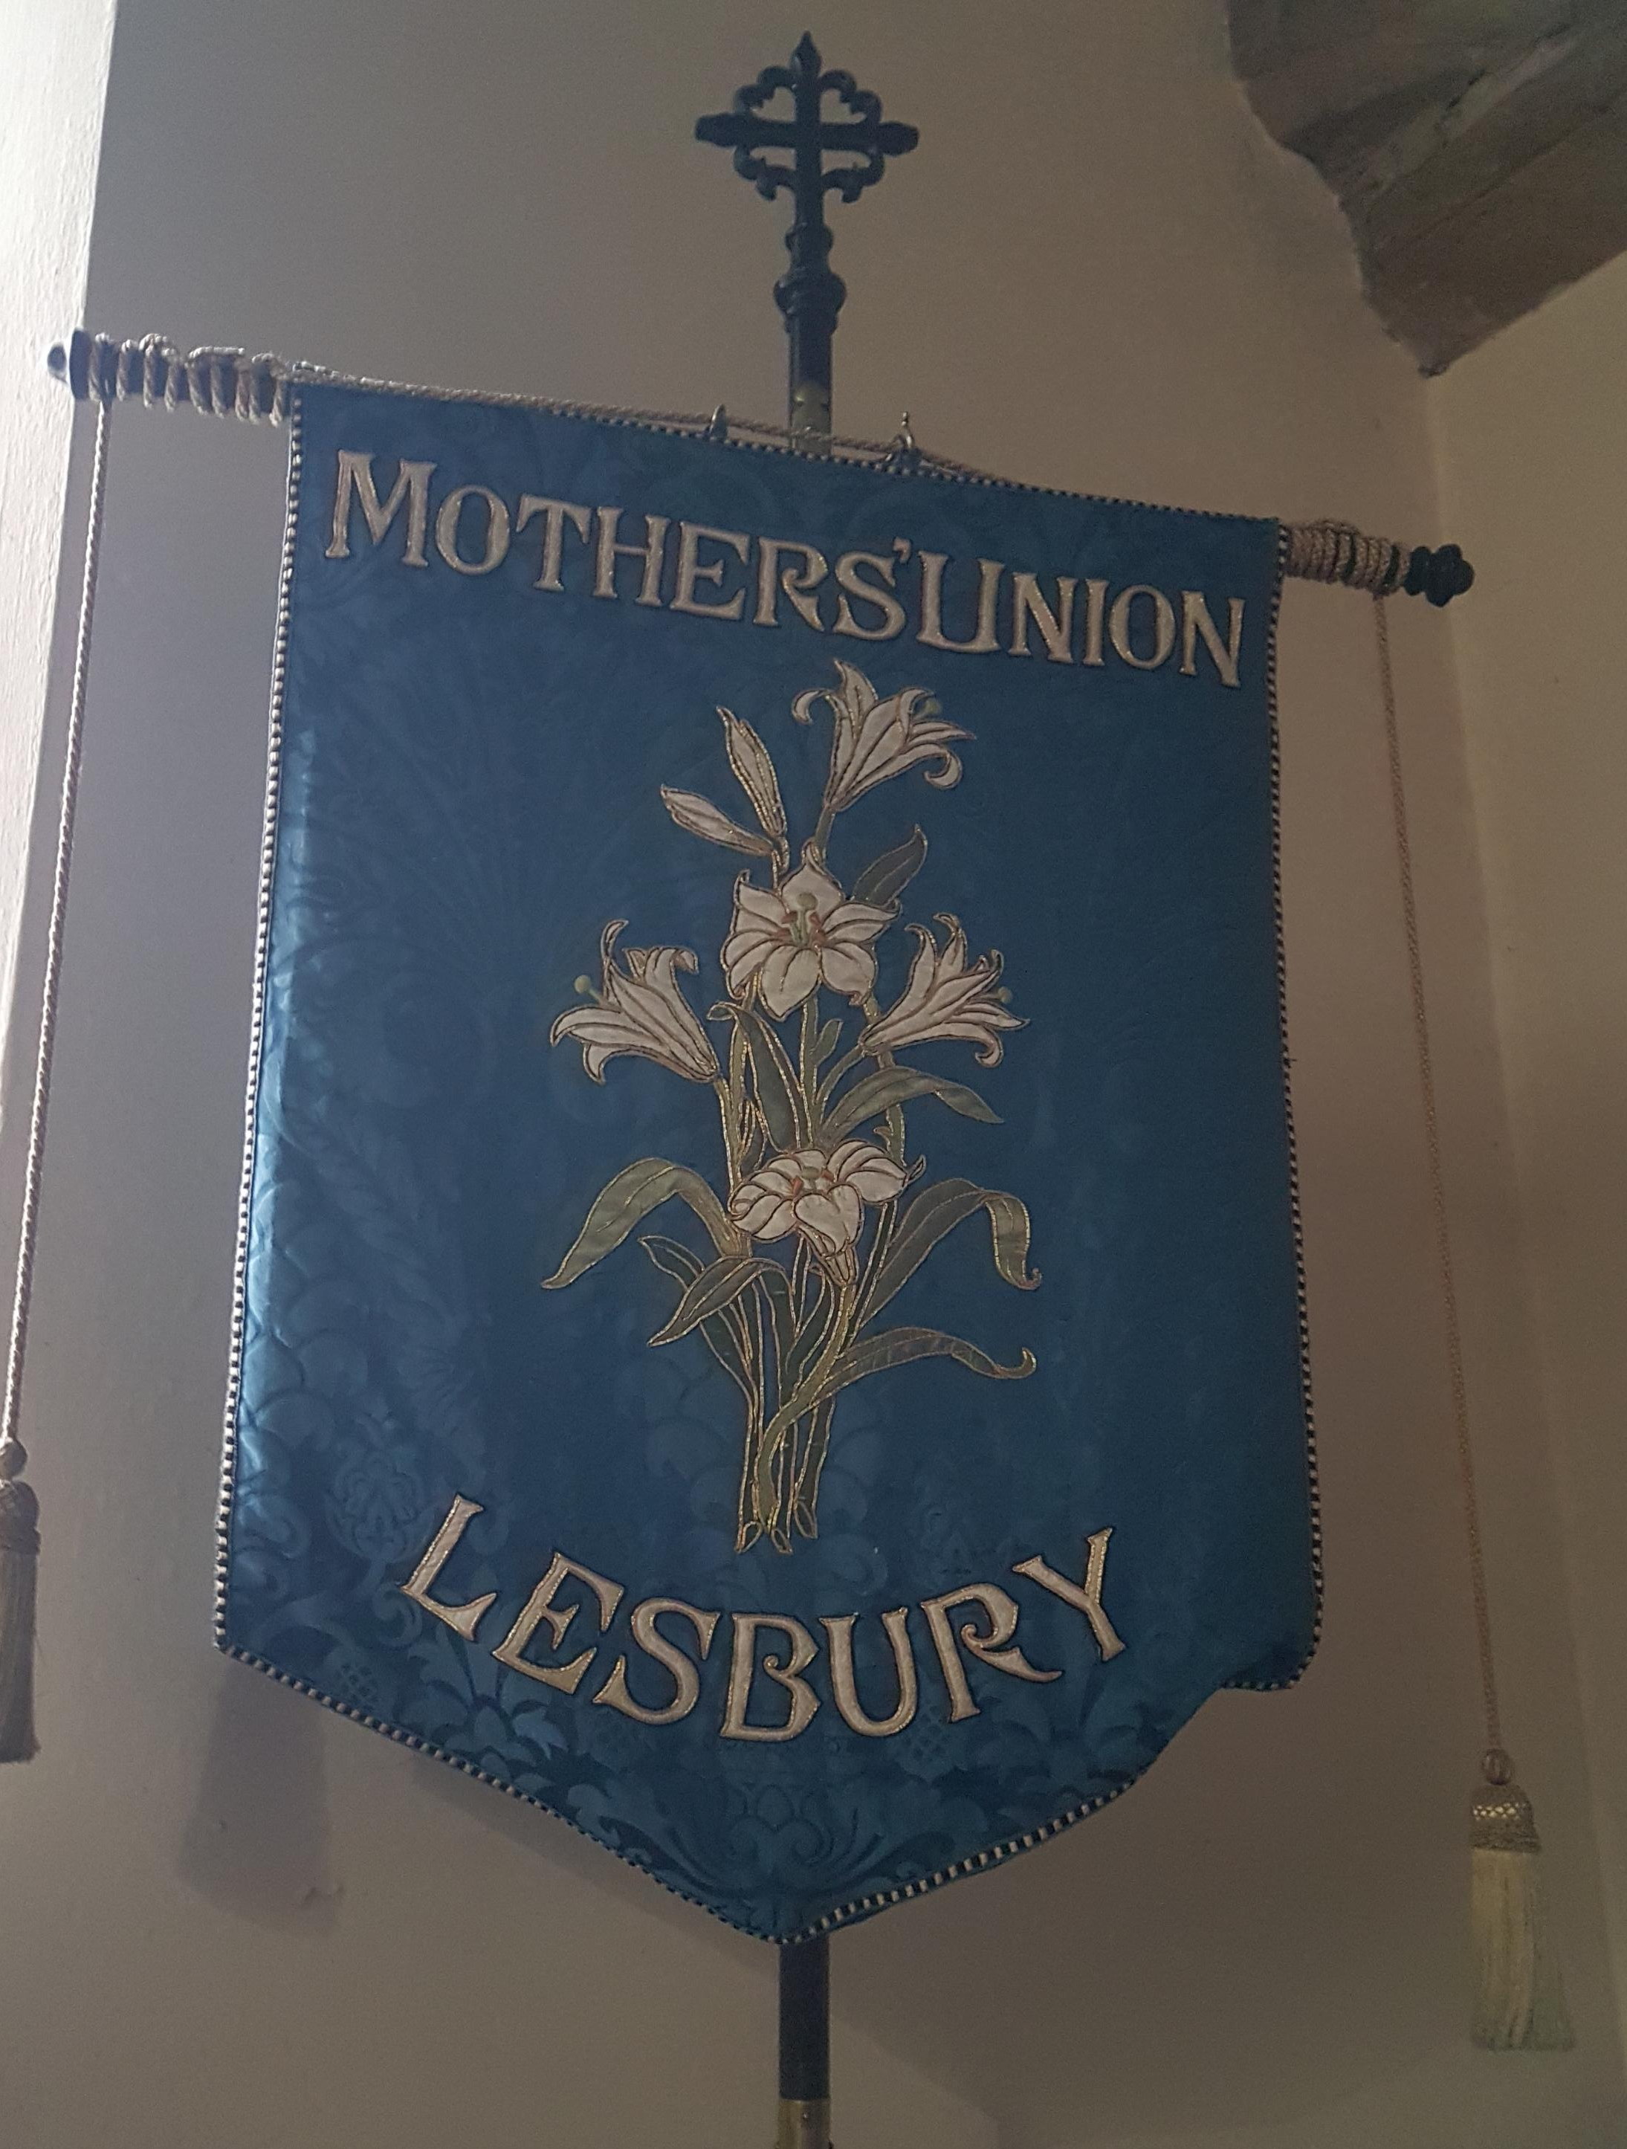
MU Lesbury

Slide 6
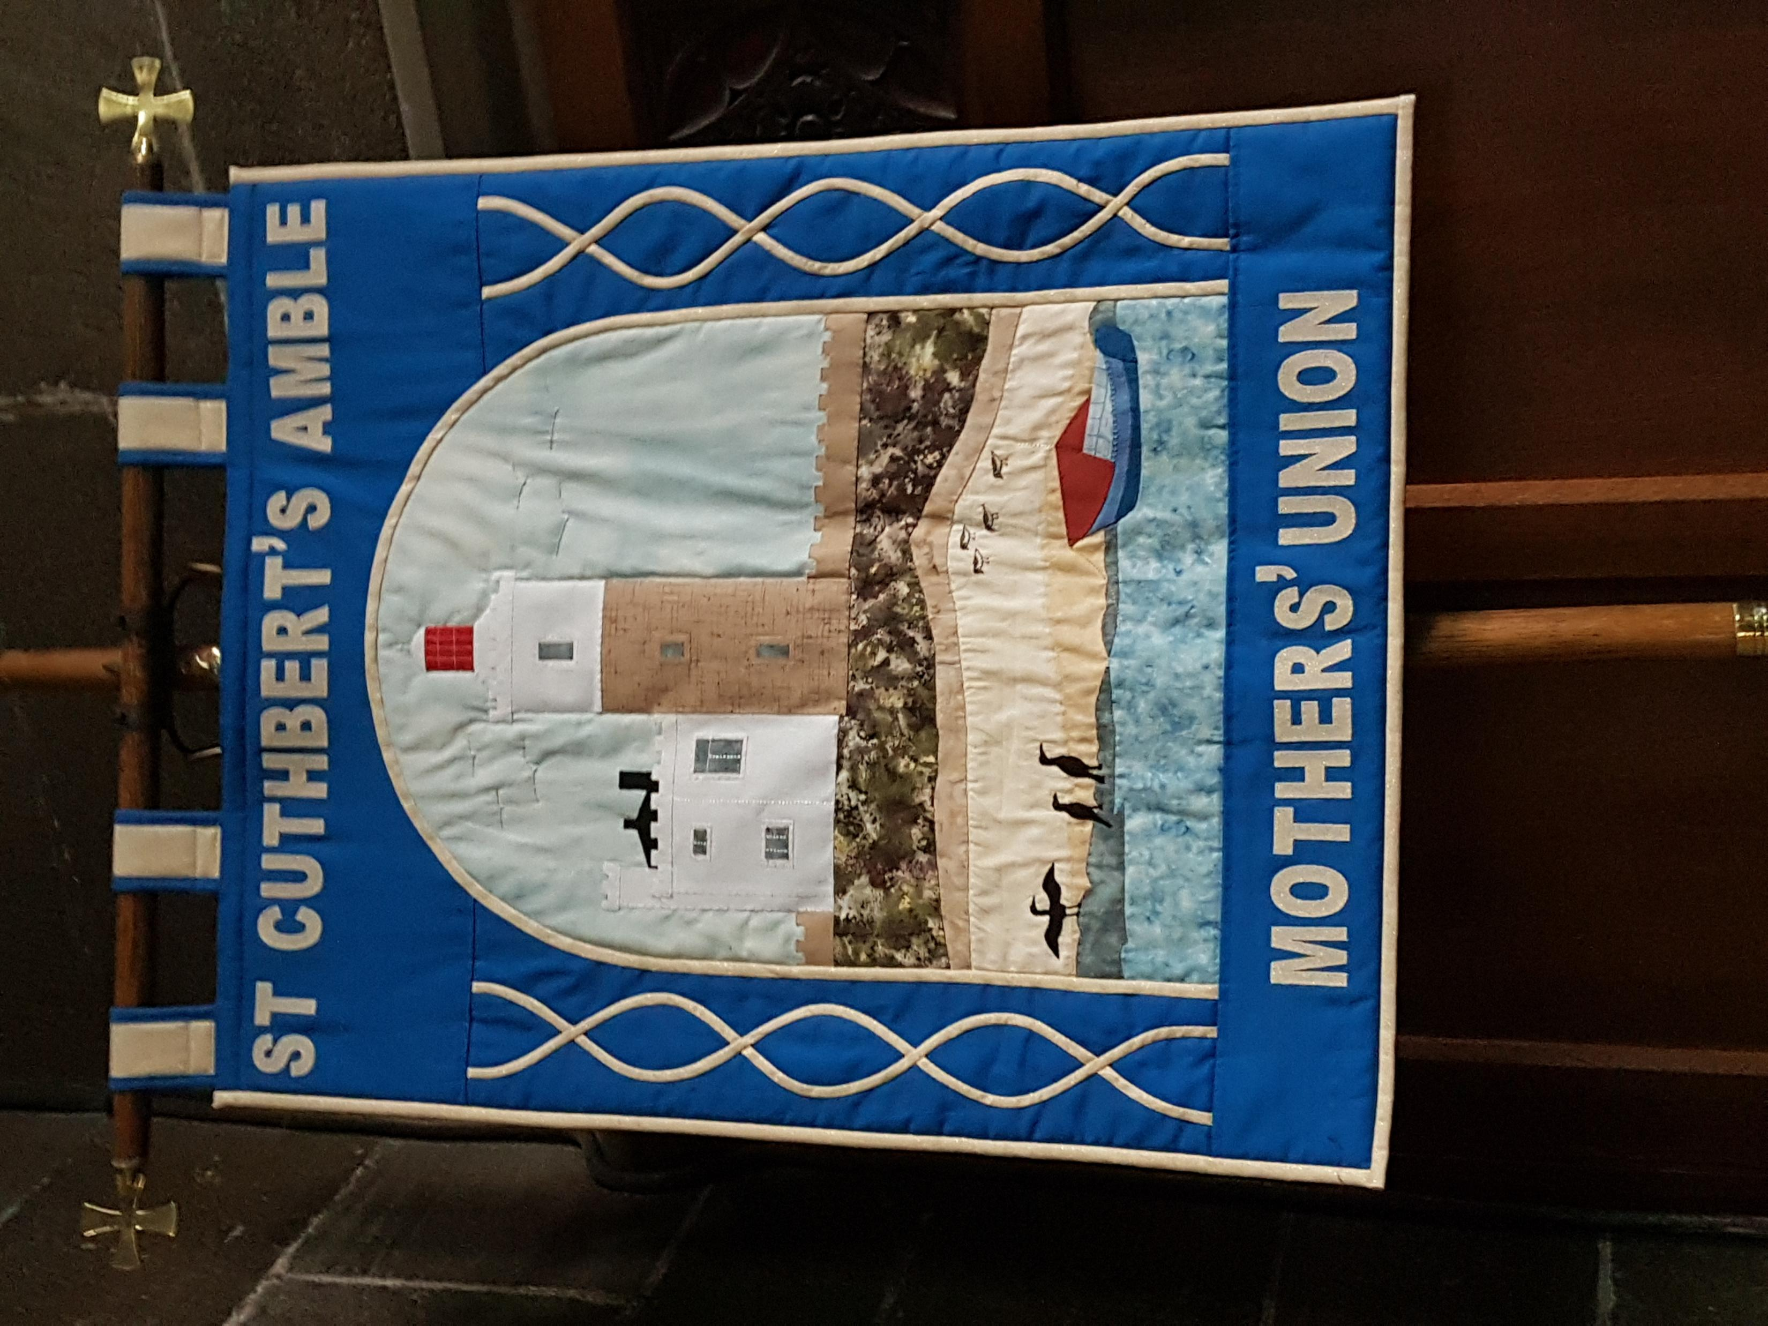
St Cuthbert’s Amble

Slide 7
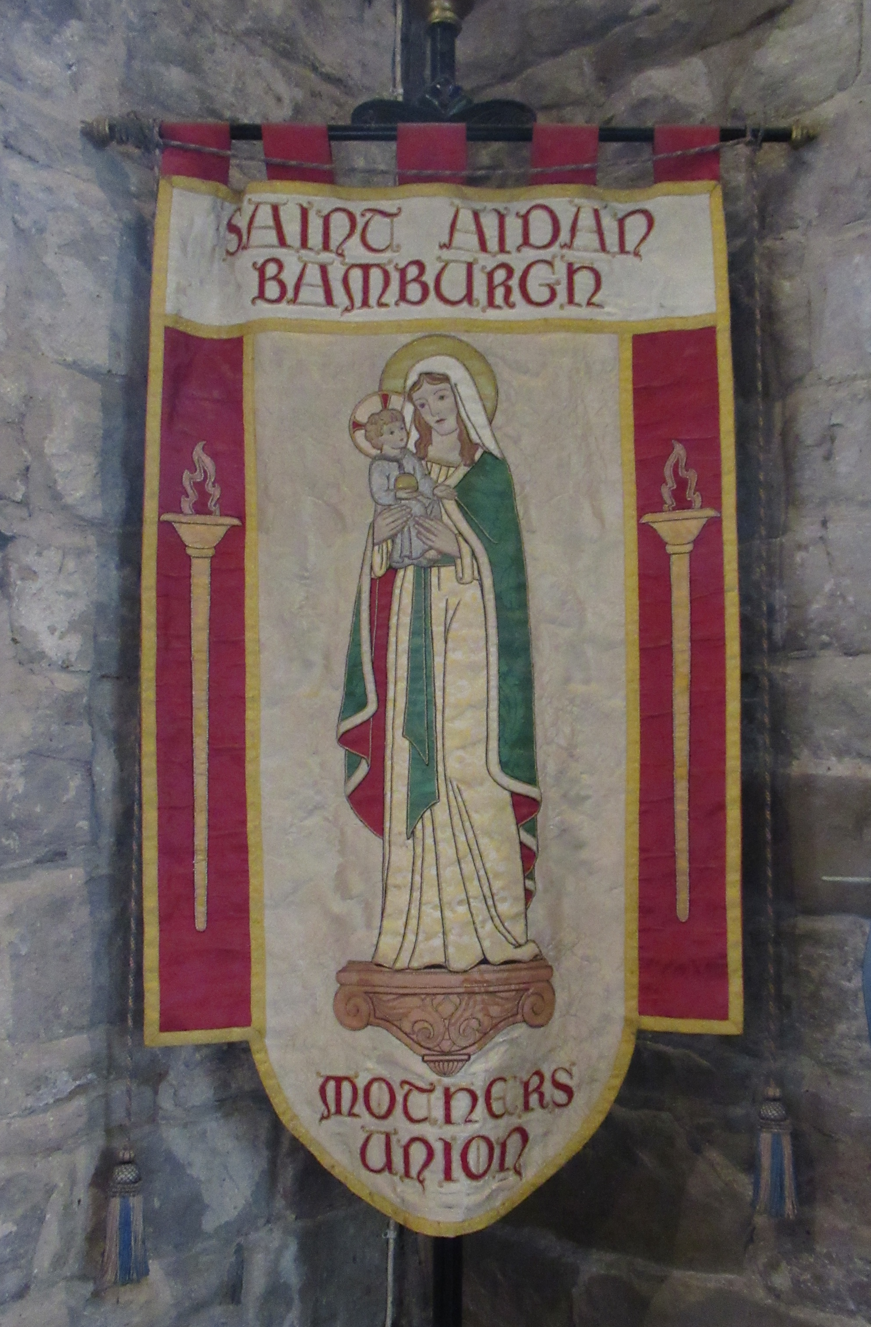
St Aidan Bamburgh

Slide 8
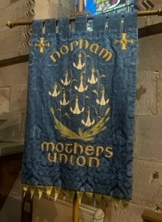
Norham Group

Slide 9
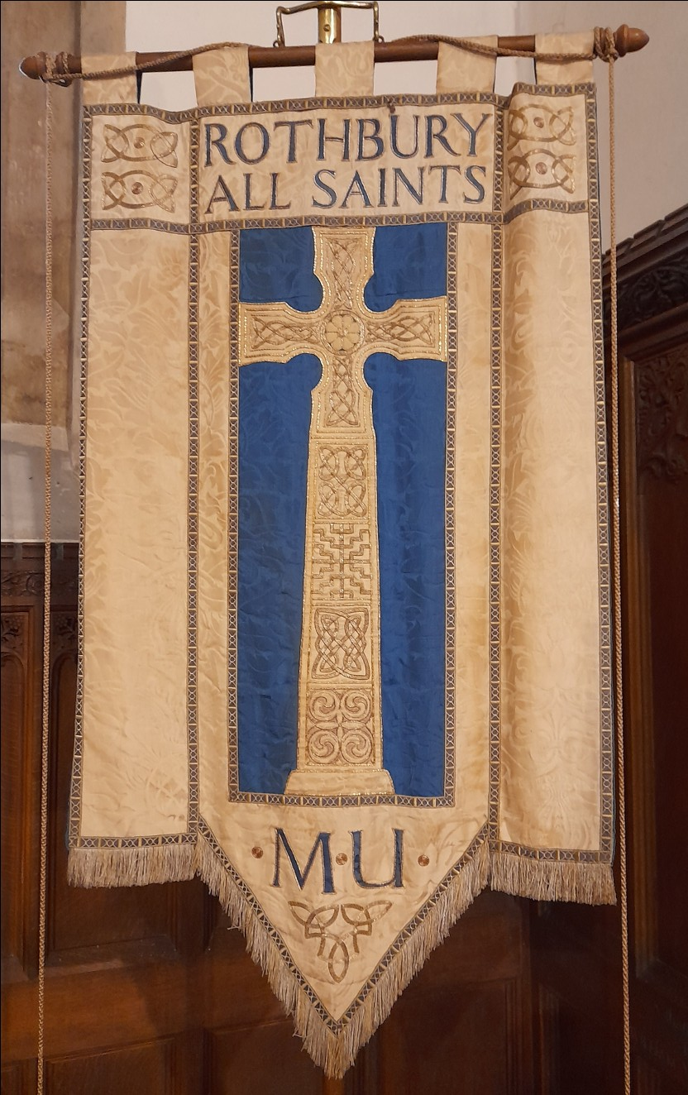
All Saints Rothbury

Slide 10
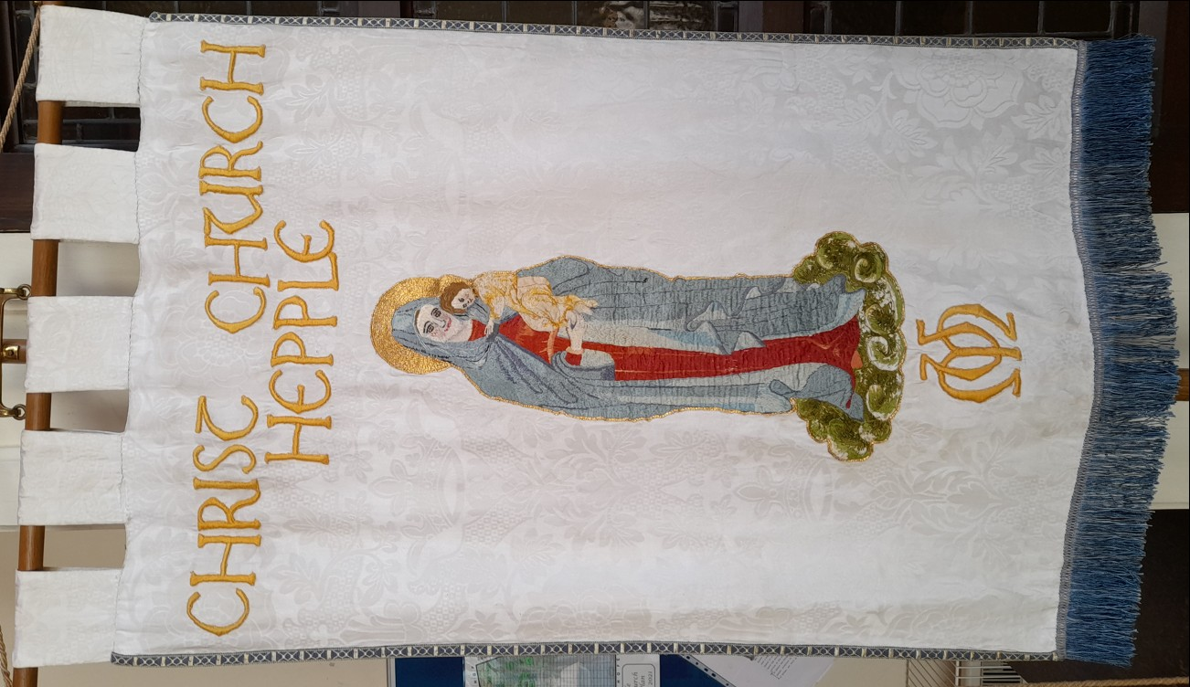
Christ Church Hepple

Slide 11
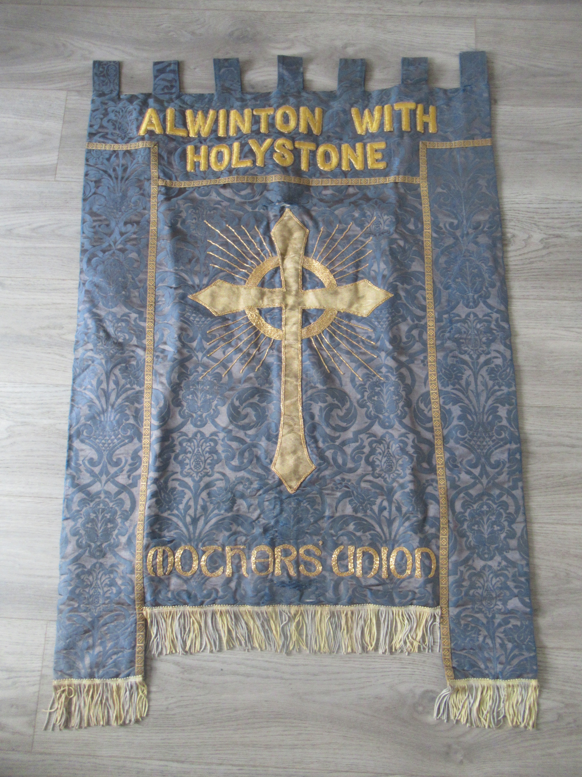
Alwinton with Holystone

Slide 12
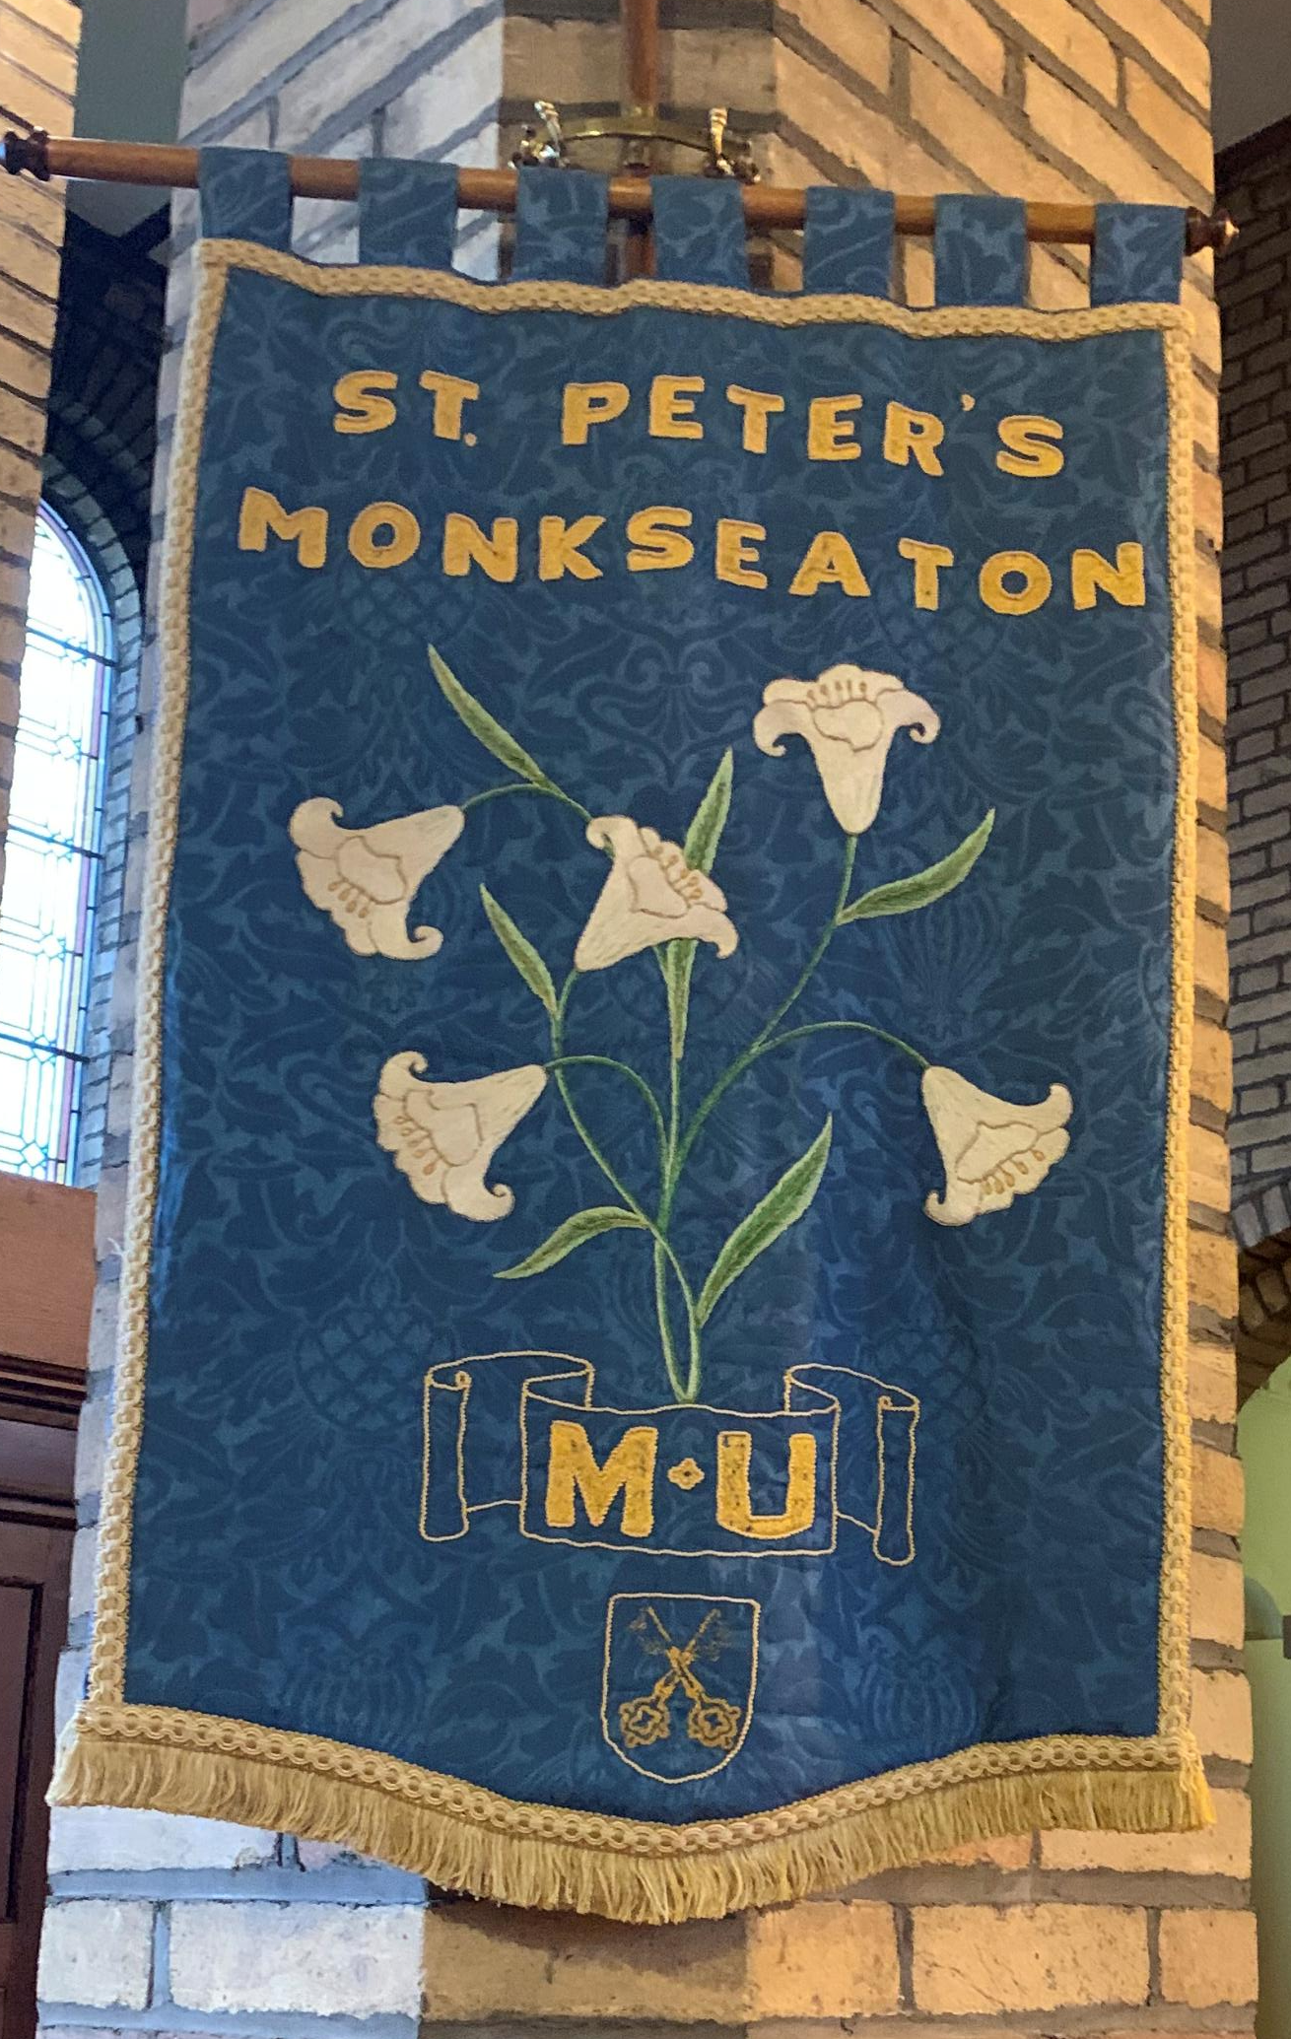
St Peter Monkseaton

Slide 13
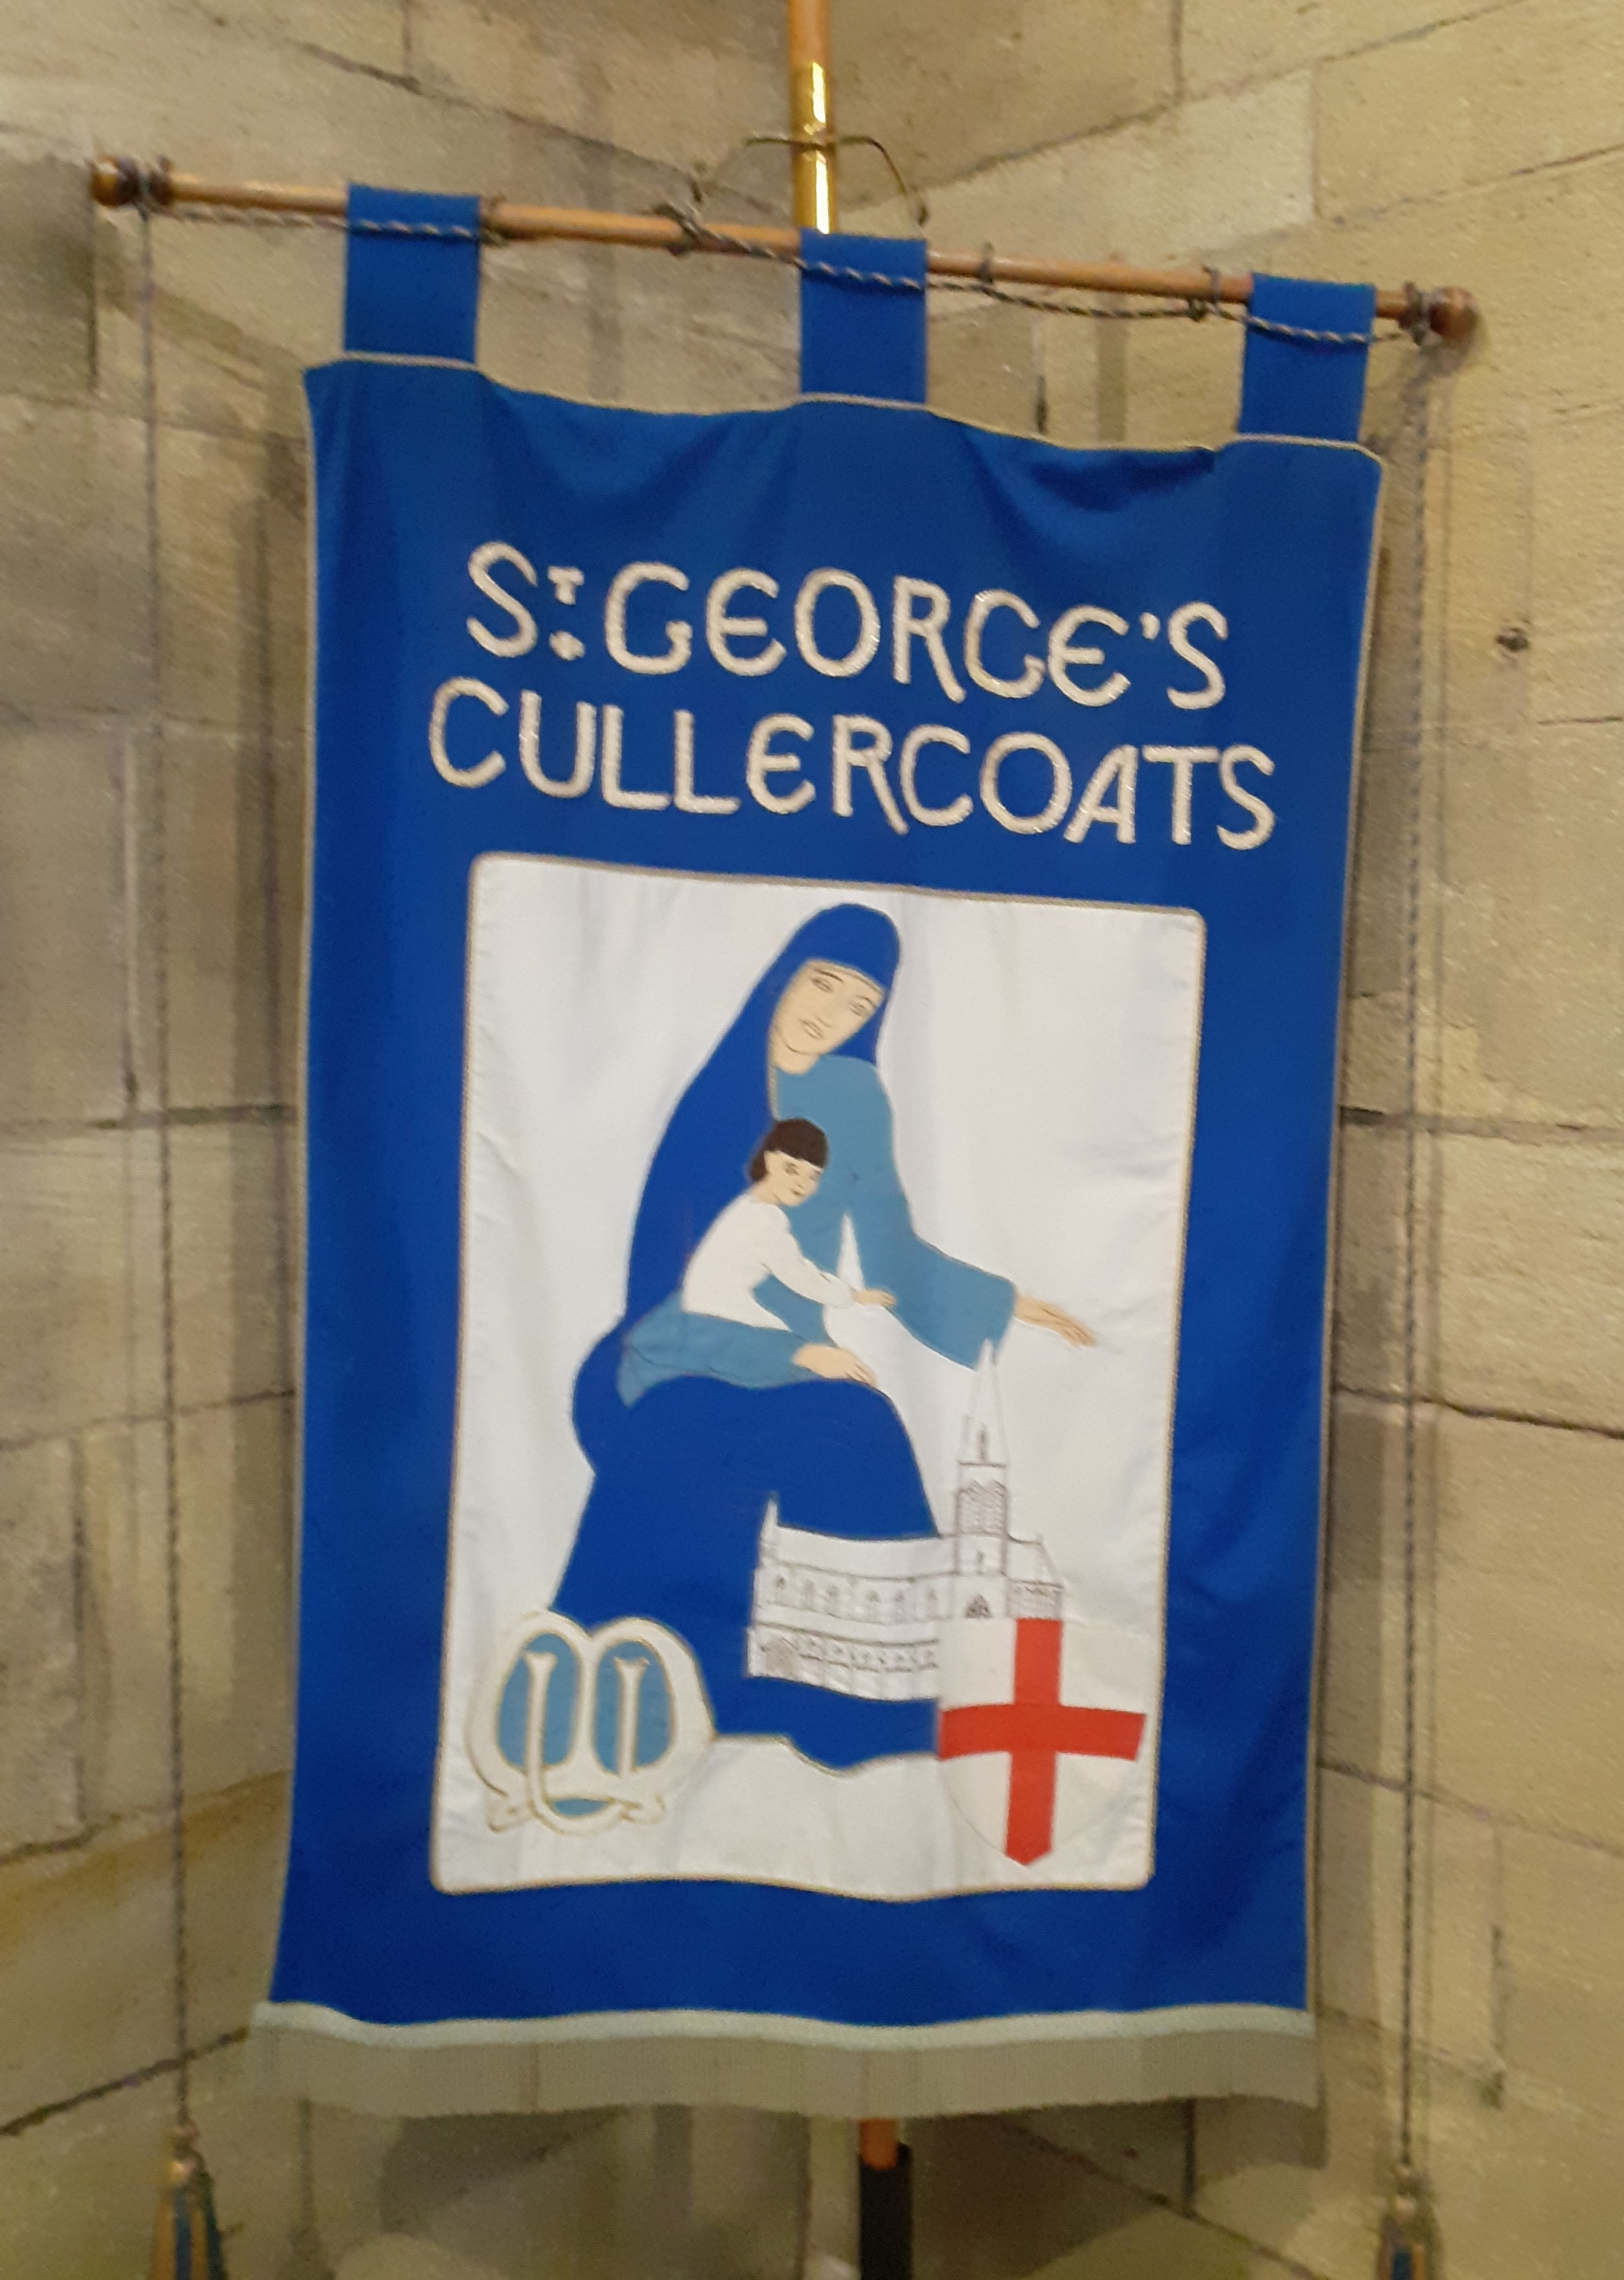
St George’s Cullercoats

Slide 14
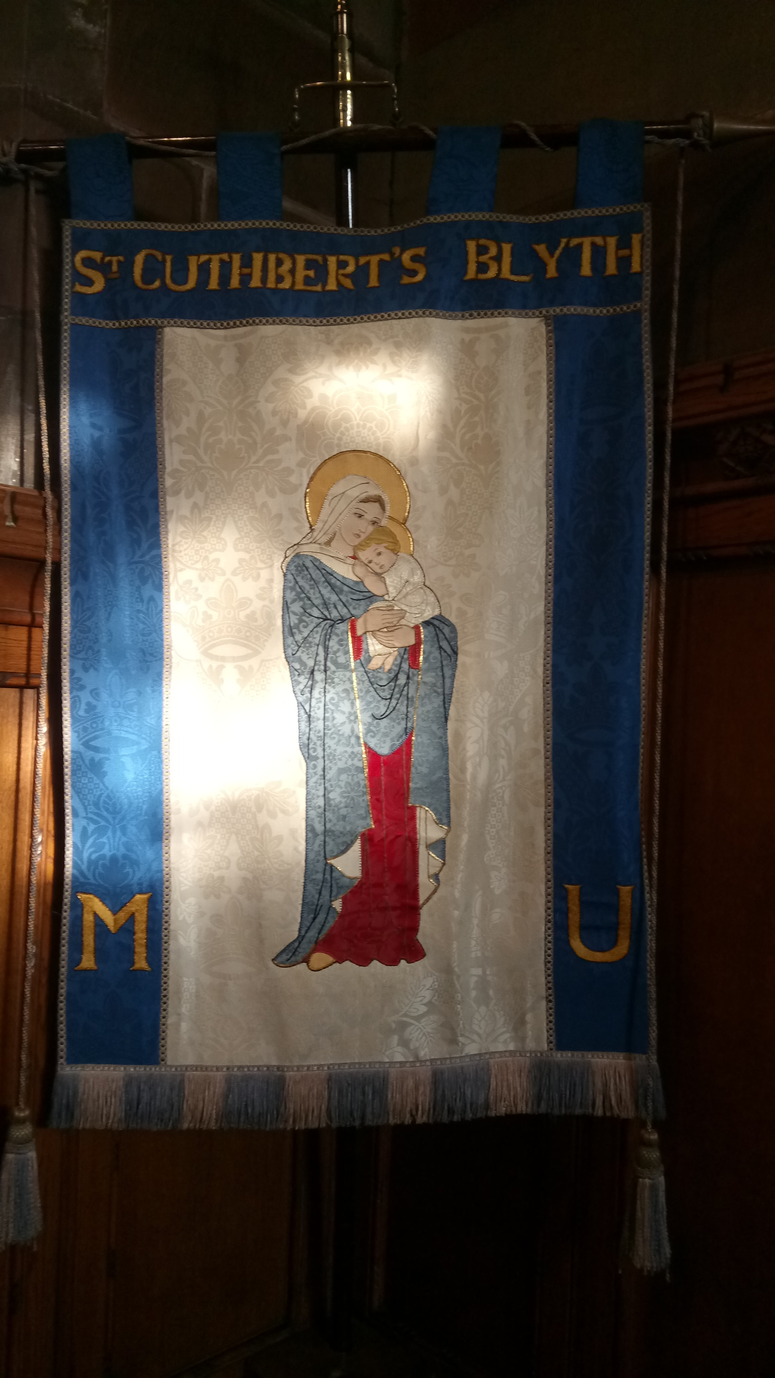
St Cuthbert’s Blyth

Slide 15
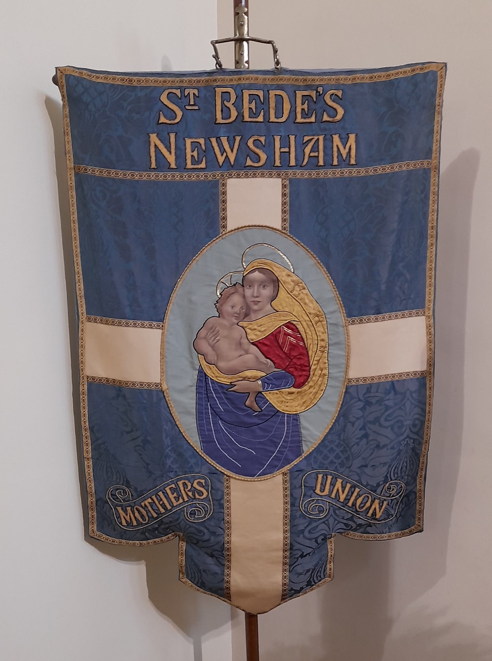
St Bede’s Newsham

Slide 16
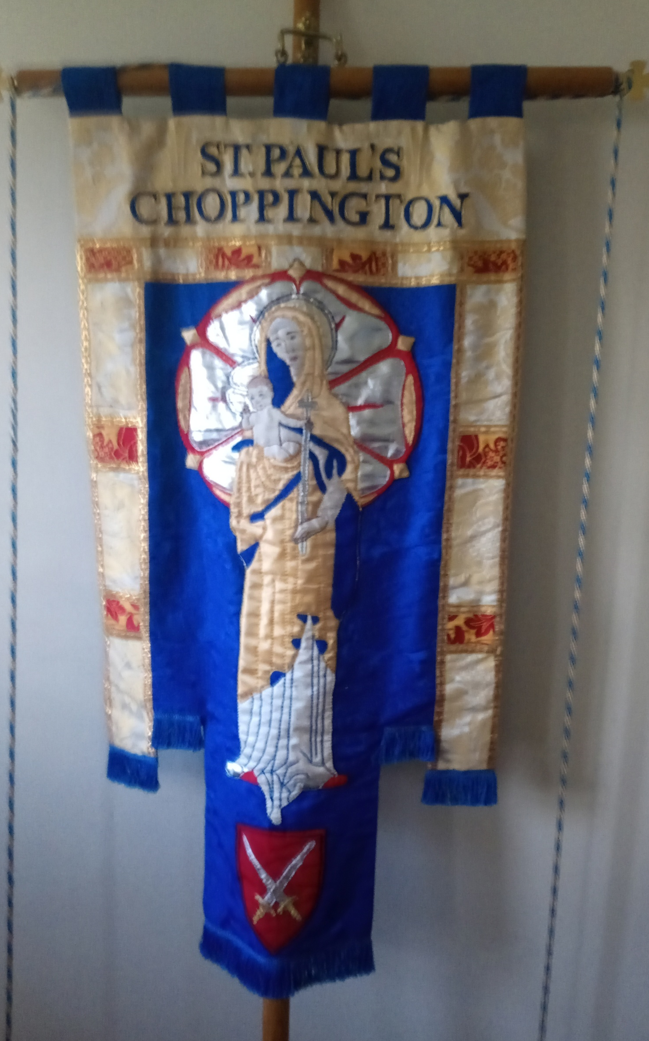
St Paul’s Choppington

Slide 17
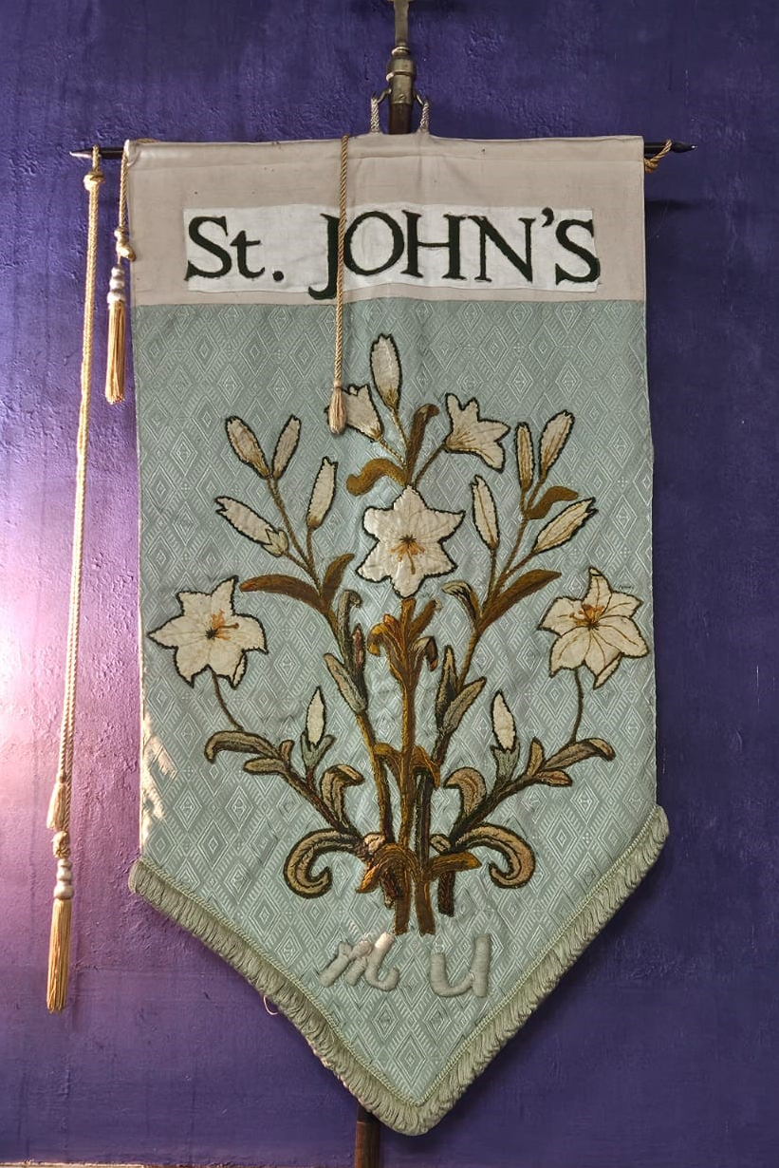
St John’s Earsdon

Slide 18
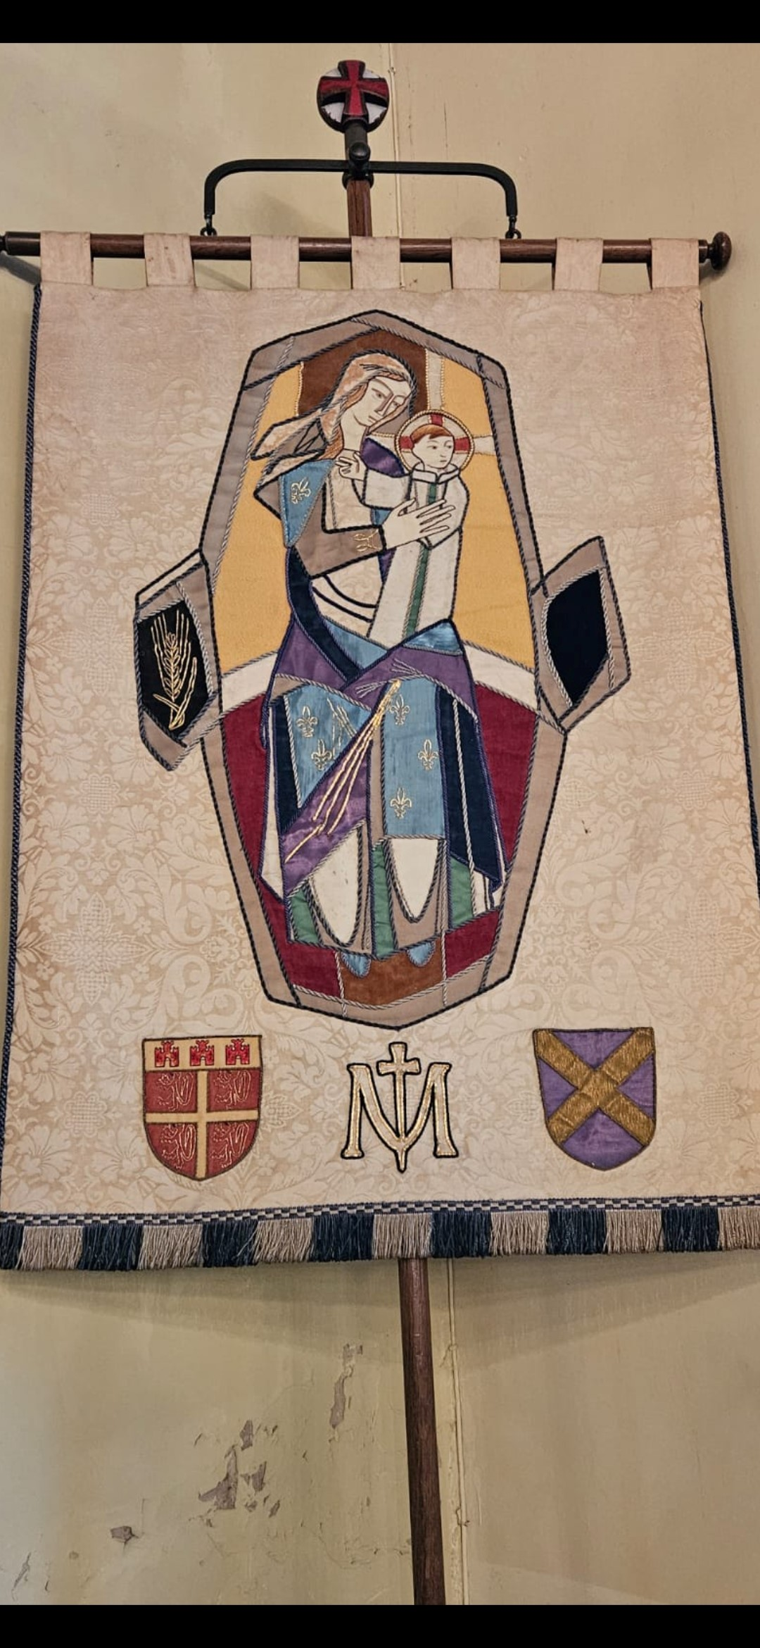
MU Earsdon and Backworth

Slide 19
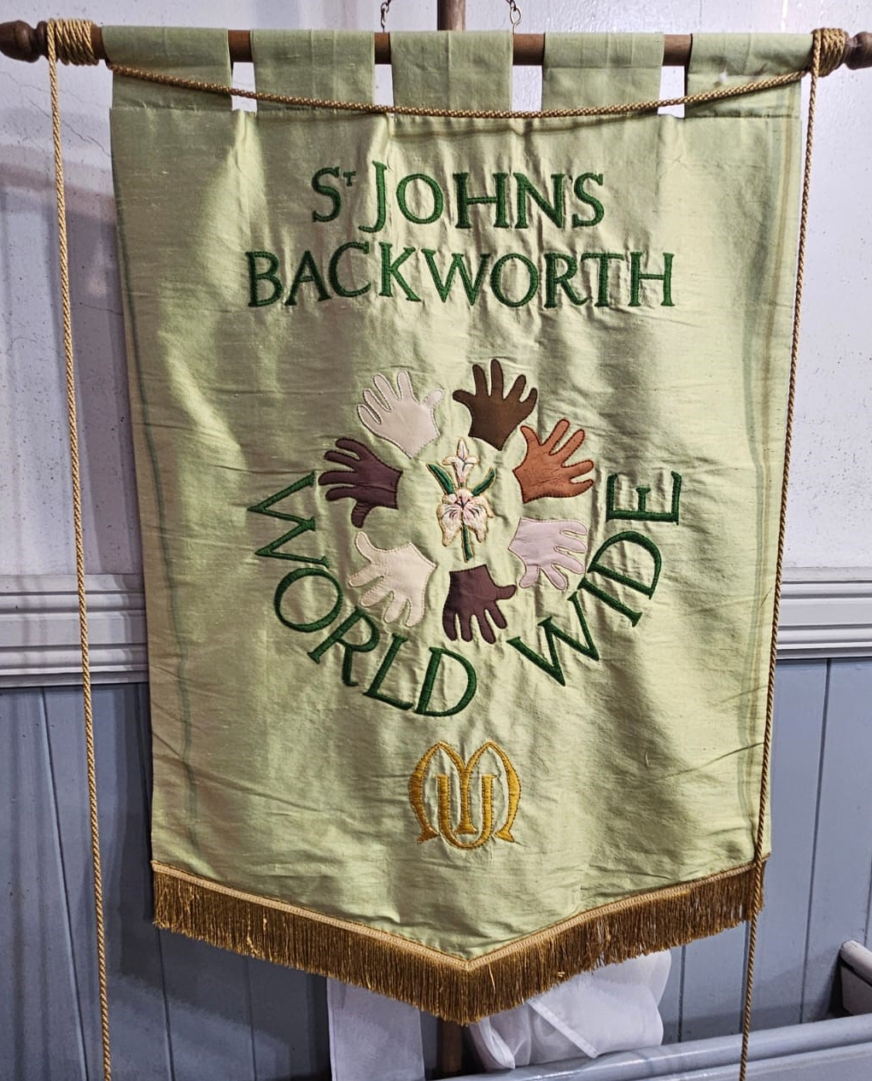
St John’s Backworth

Slide 20
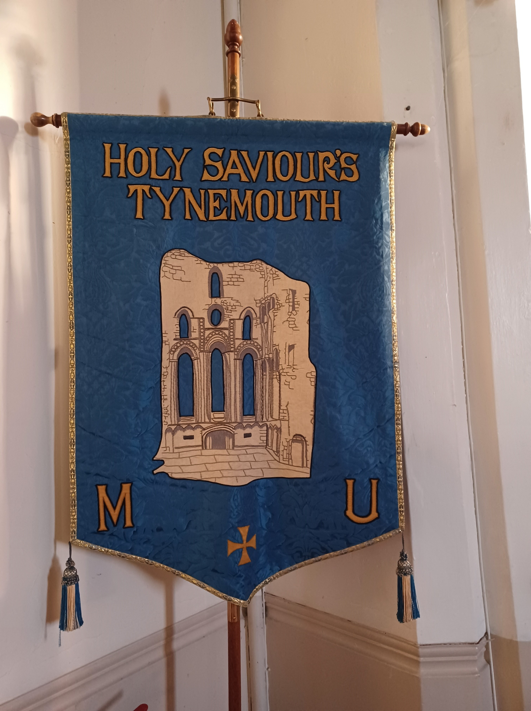
Holy Saviour Tynemouth

Slide 21
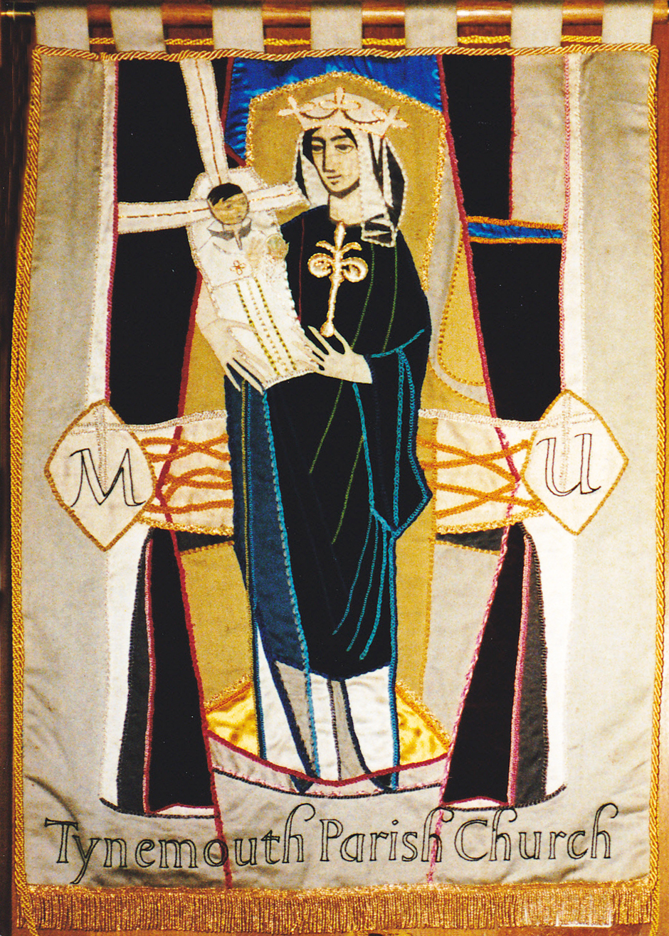
Christ Church North Shields

Slide 22
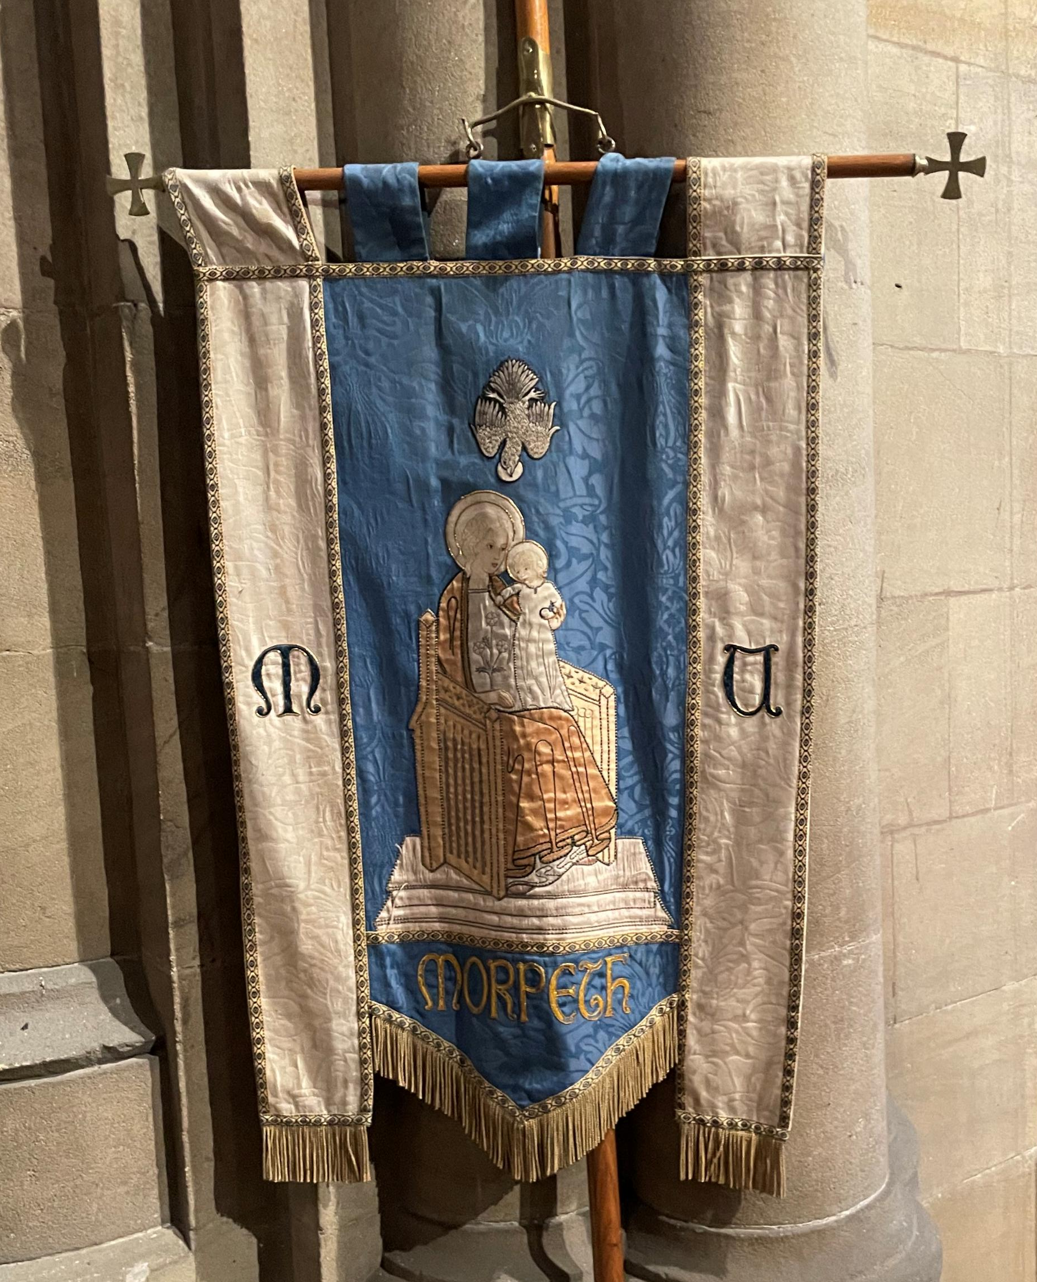
MU Morpeth

Slide 23
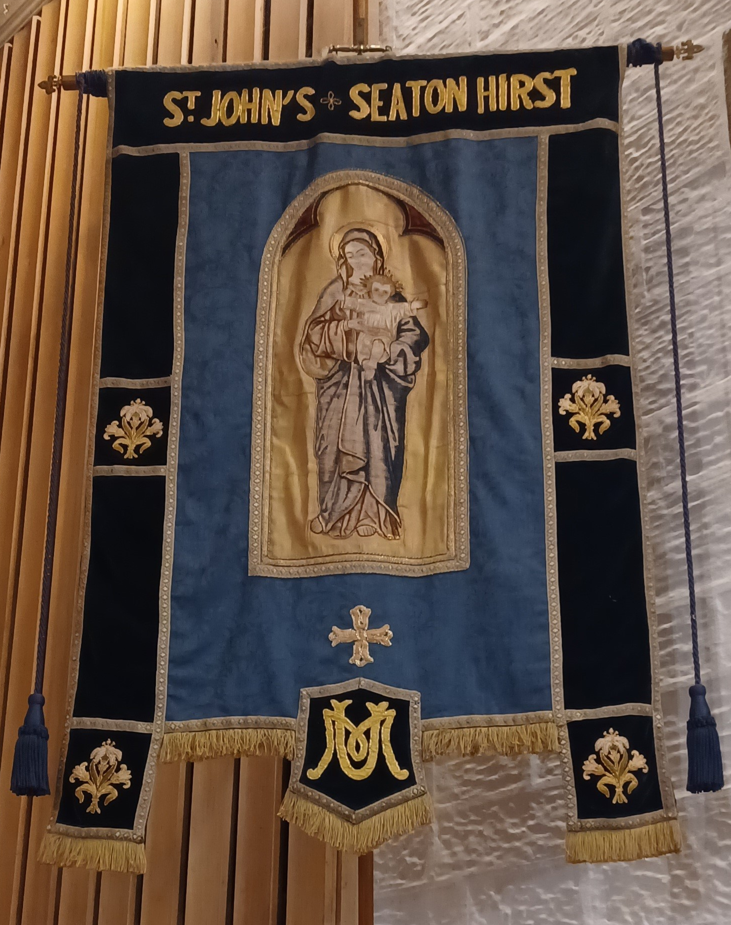
St John Seaton Hirst

Slide 24
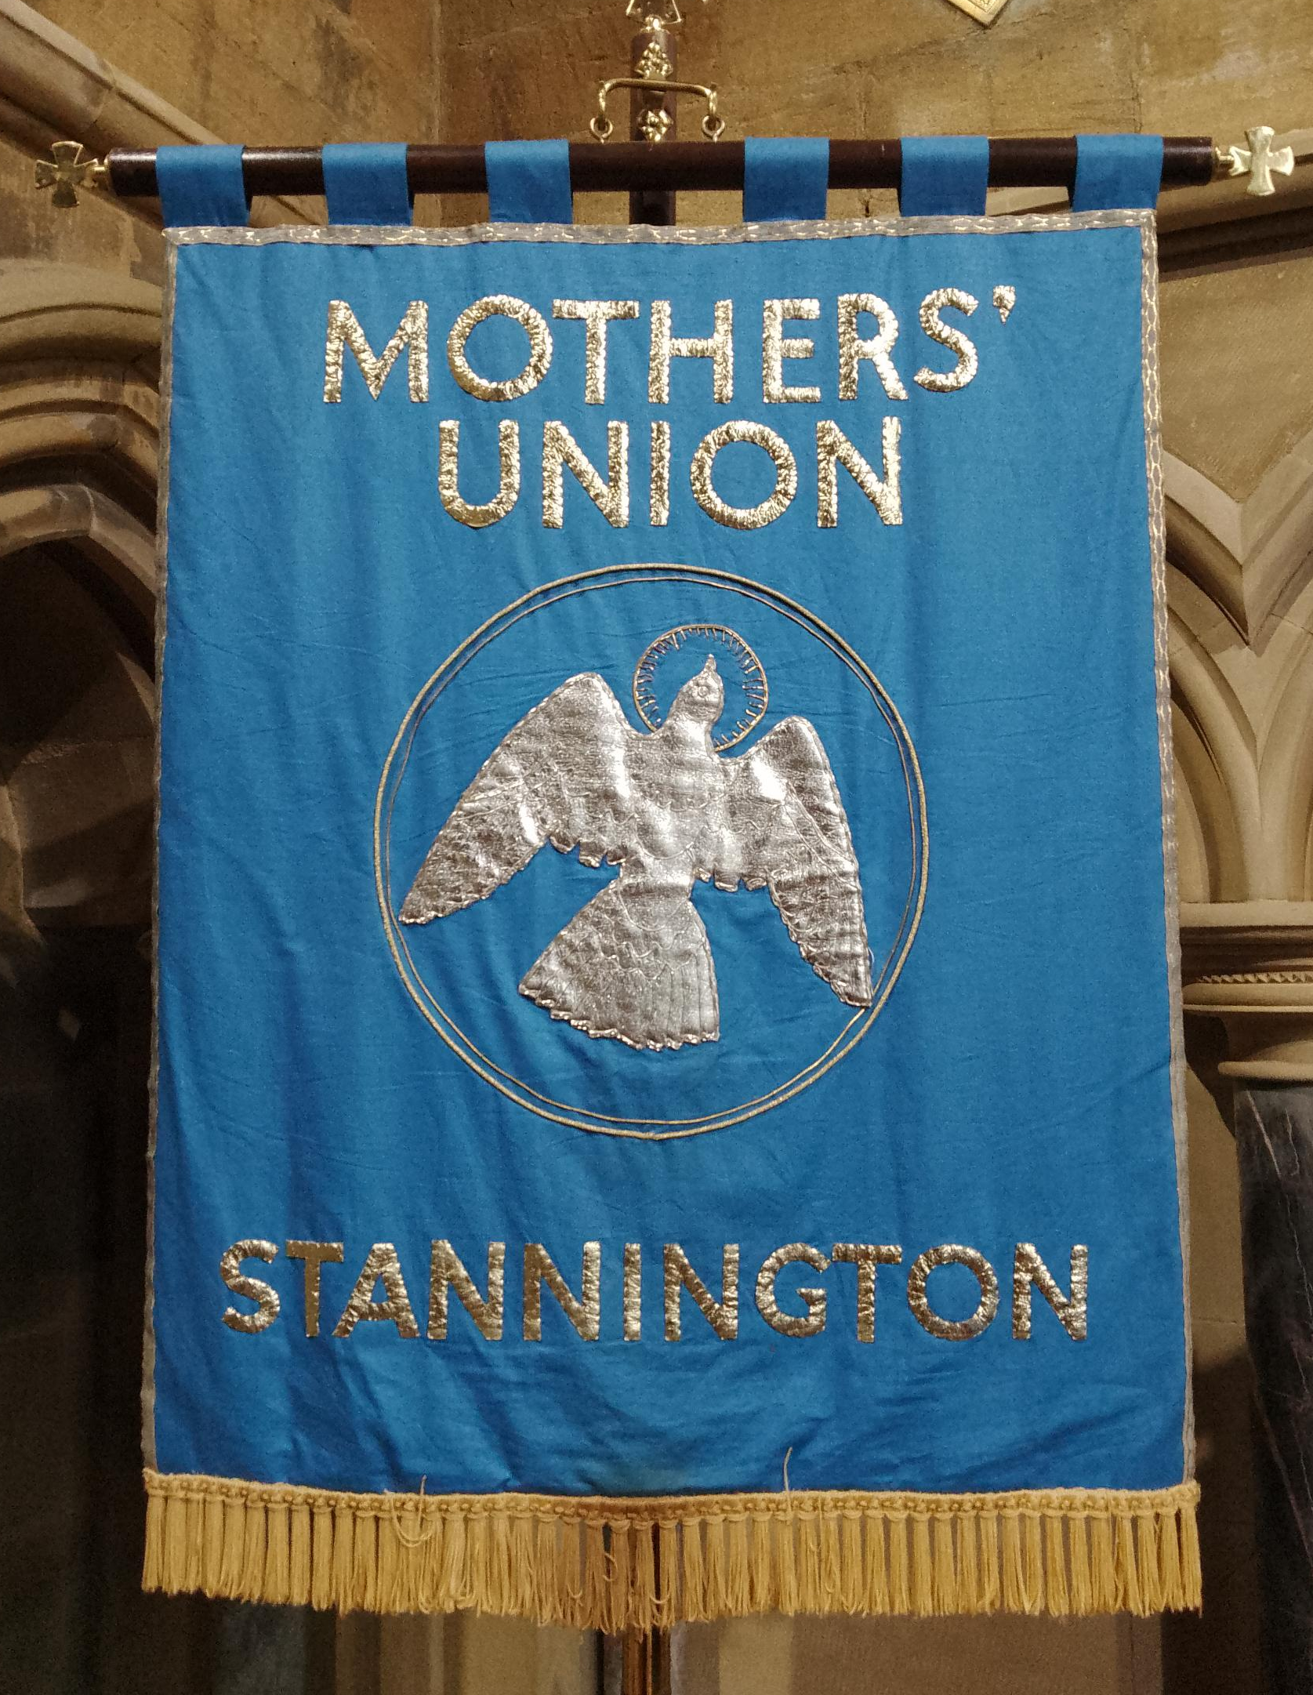
MU Stannington

Slide 25
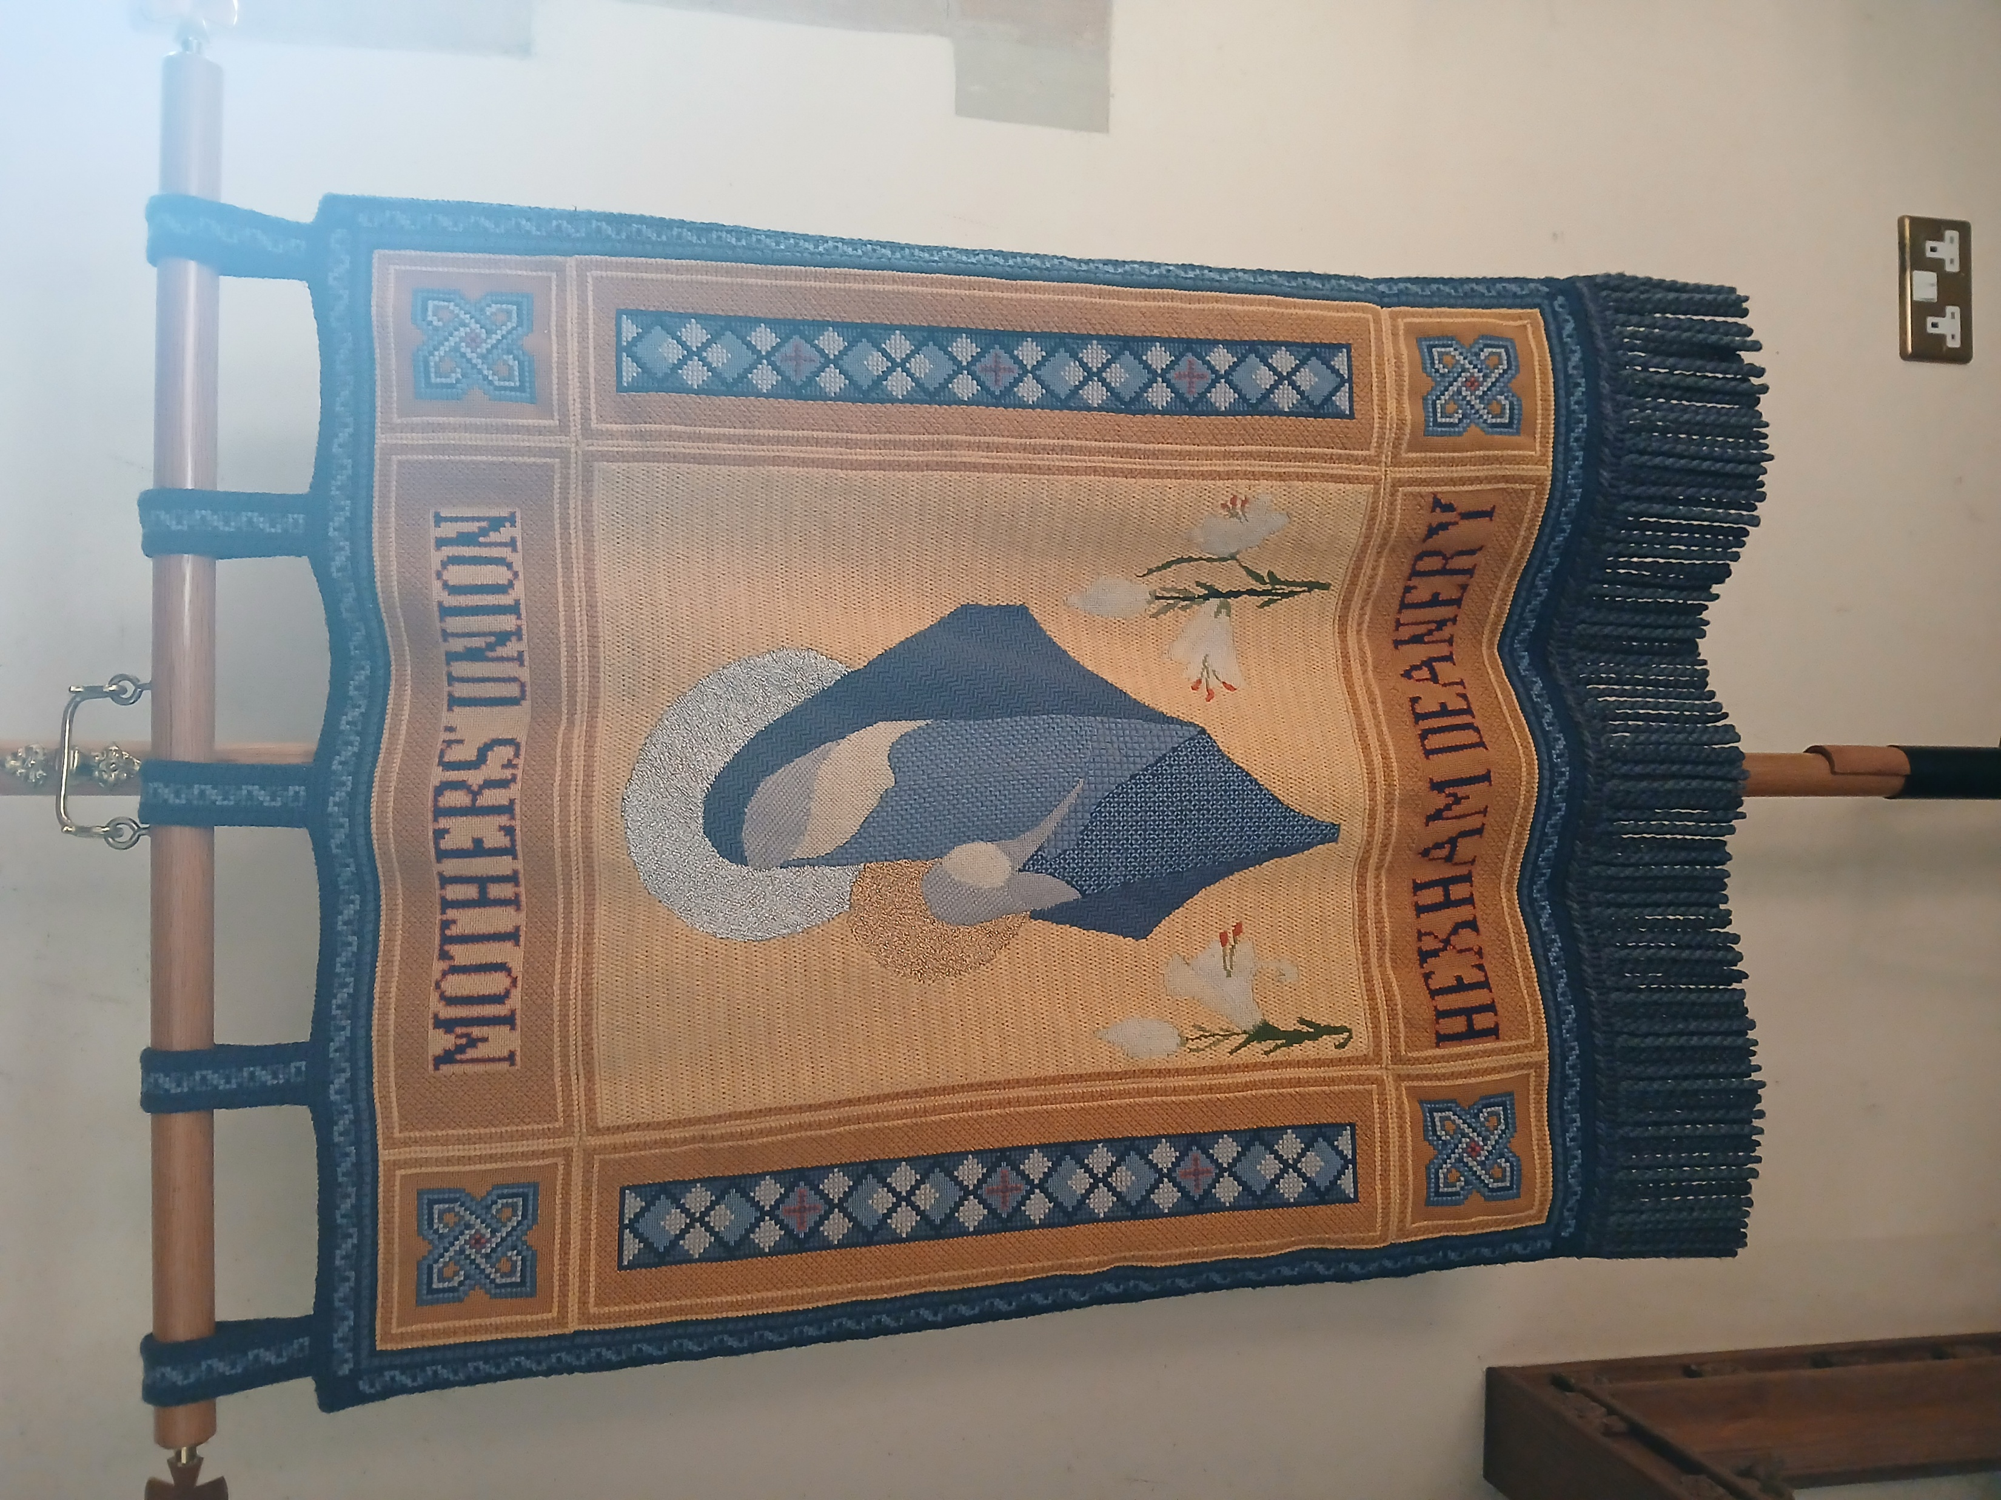
Hexham Deanery

Slide 26
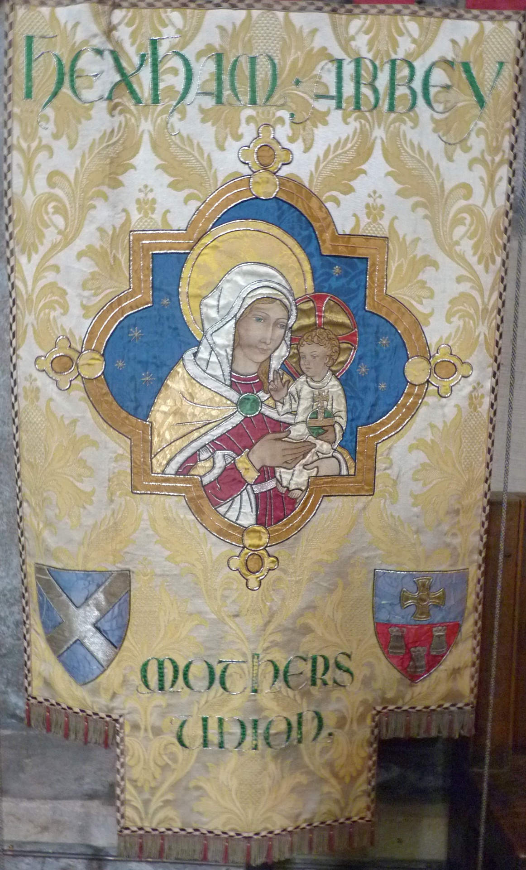
Hexham Abbey

Slide 27
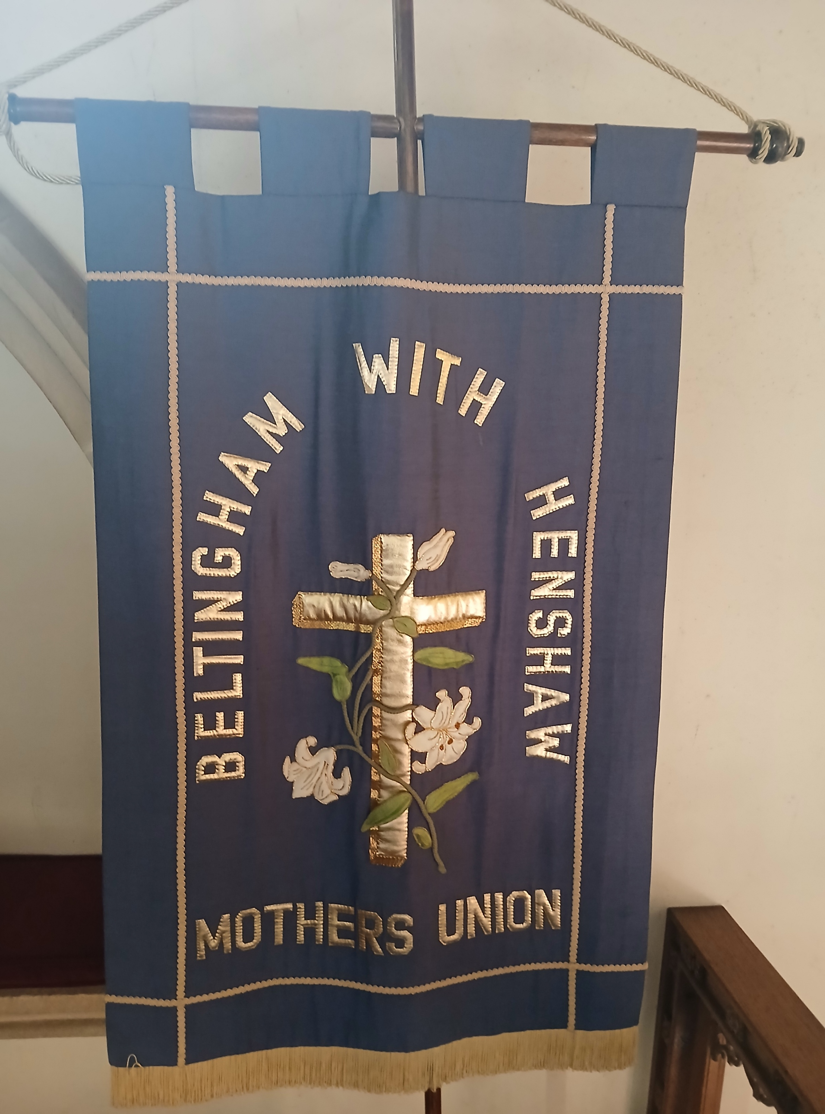
MU Beltingham
with Henshaw

Slide 28
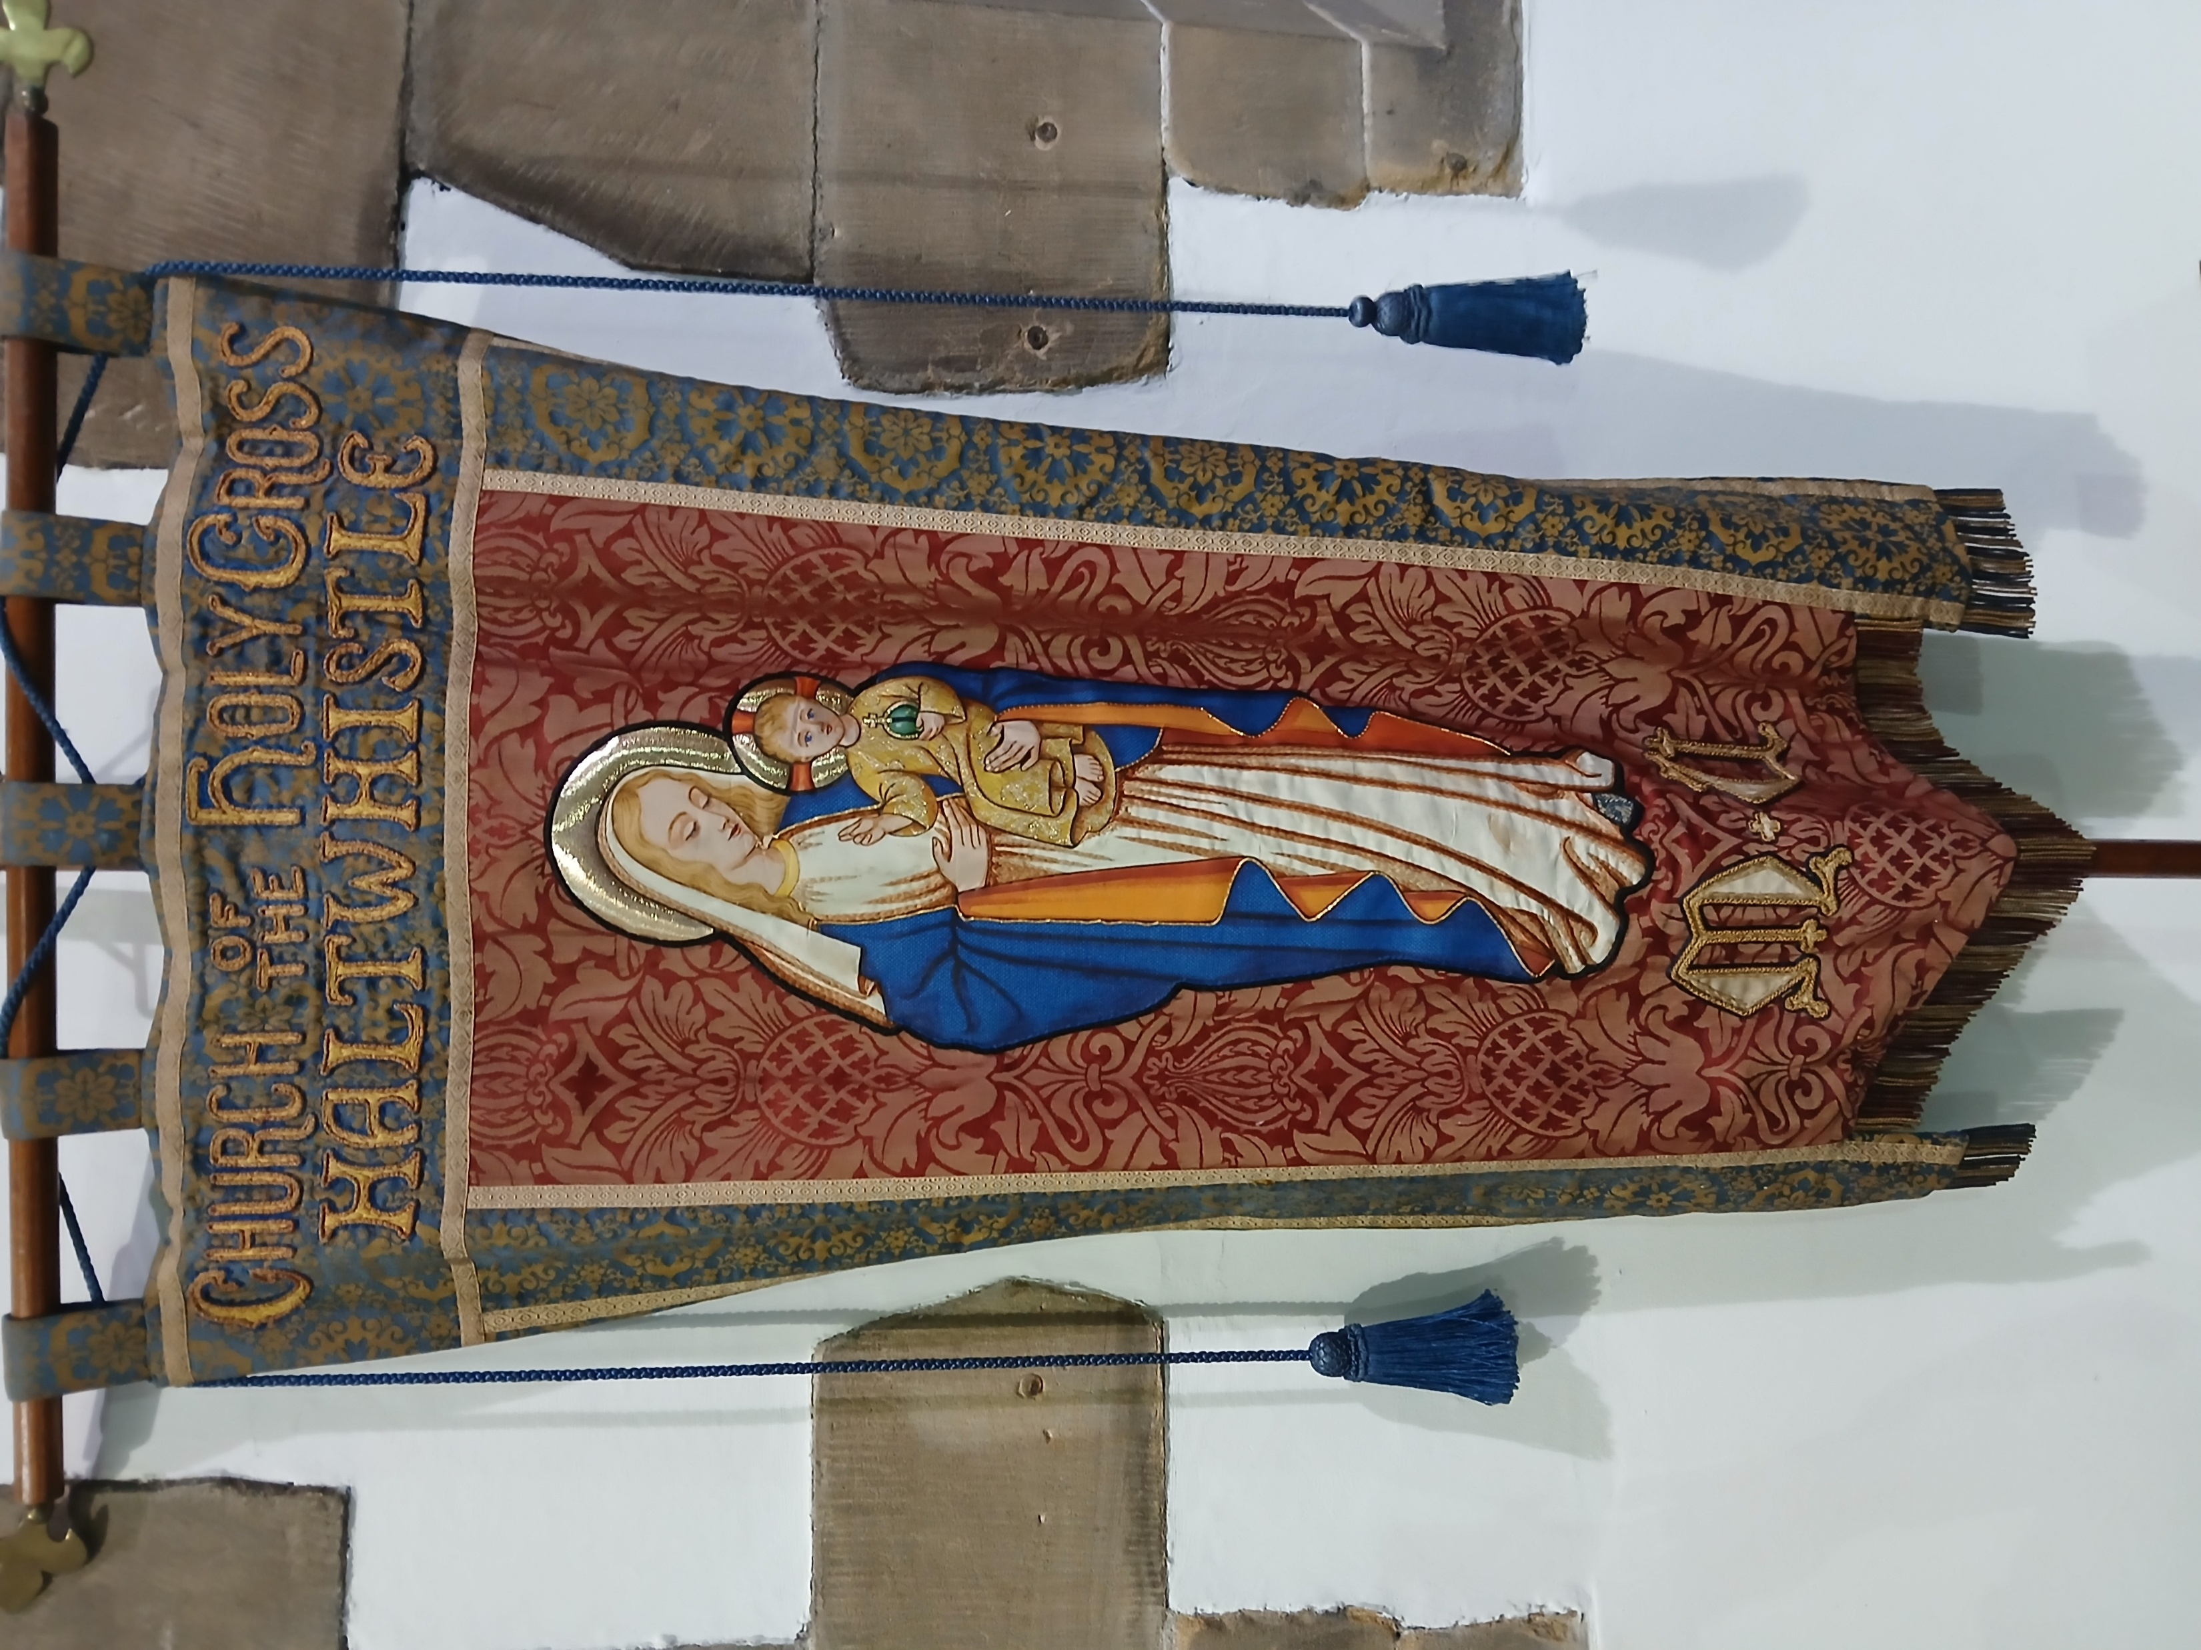
Holy Cross
Haltwhistle

Slide 29
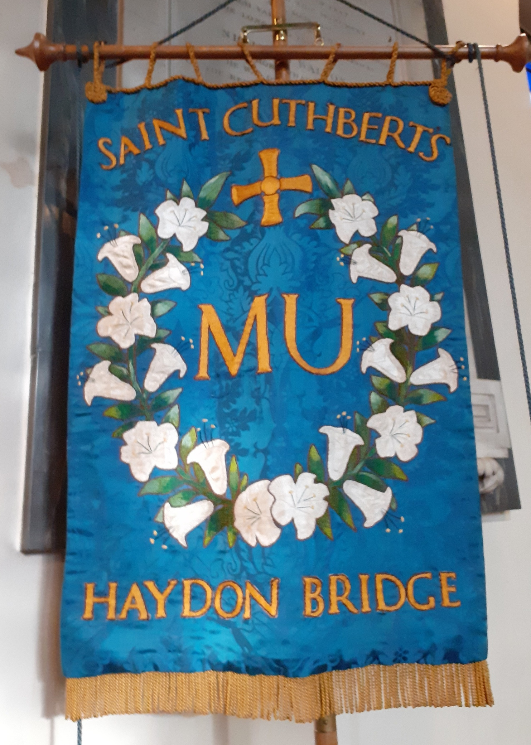
St Cuthbert’s Haydon Bridge

Slide 30
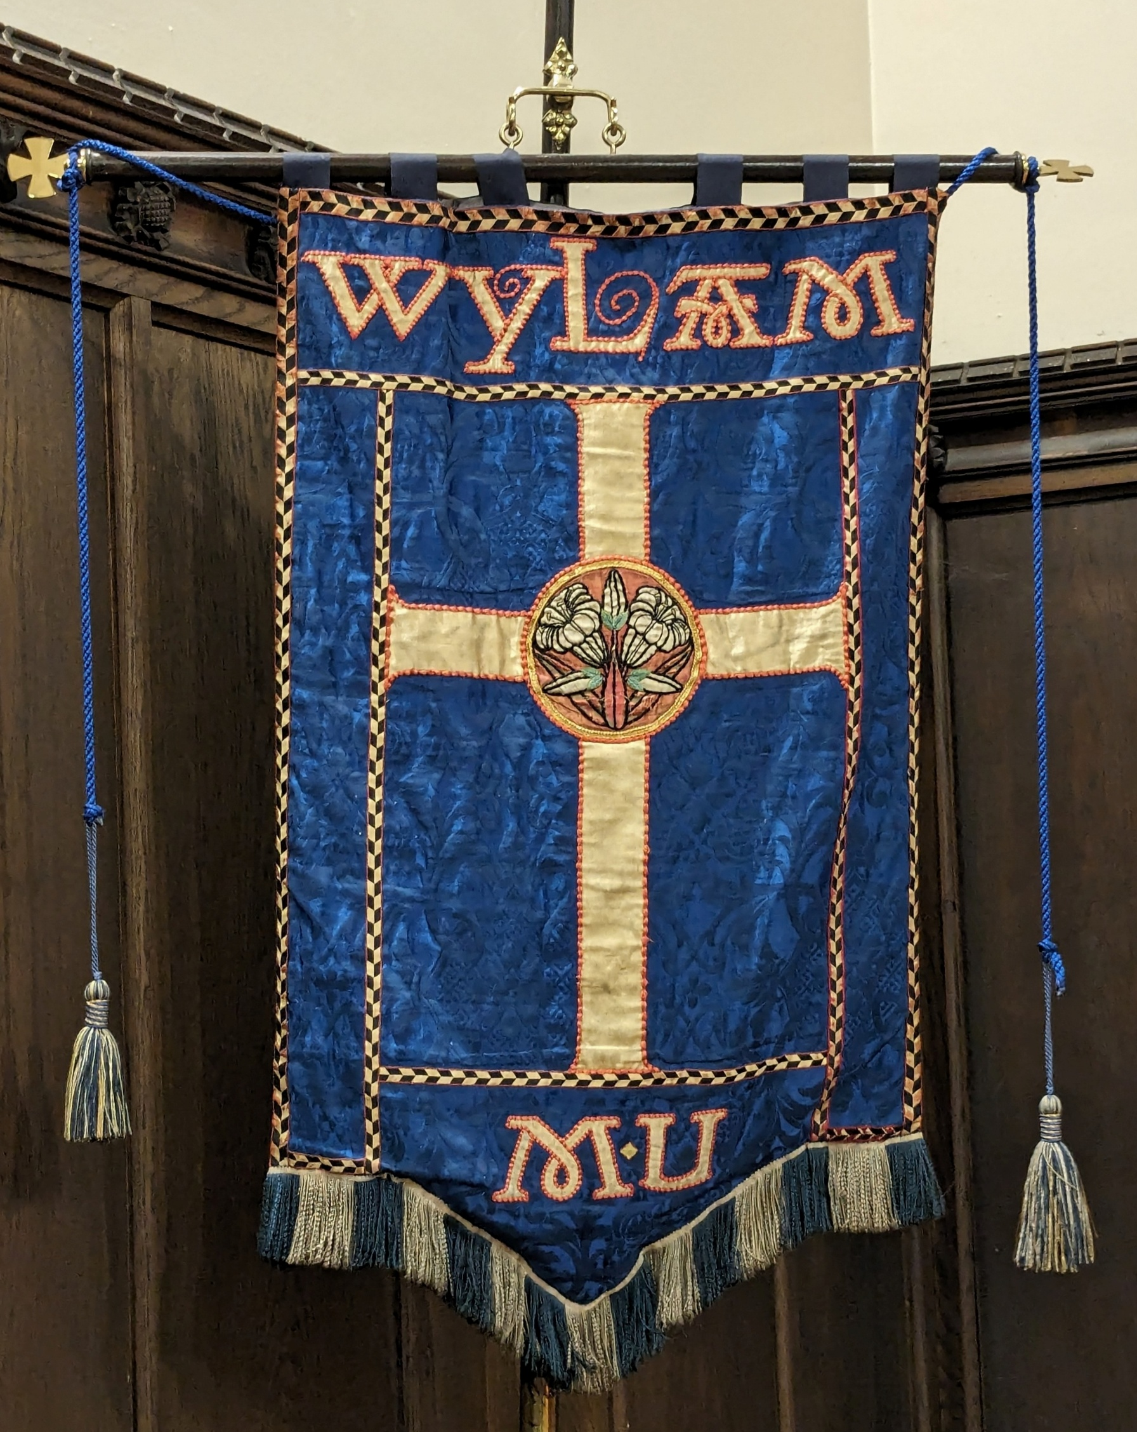
St Oswin Wylam

Slide 31
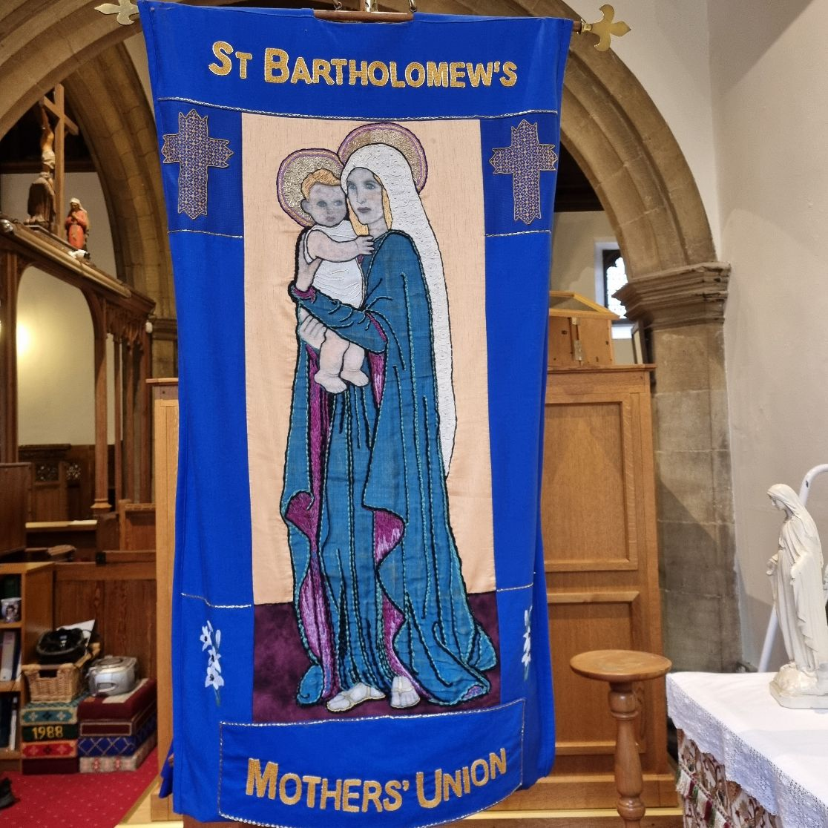
St Bartholemew Longbenton

Slide 32
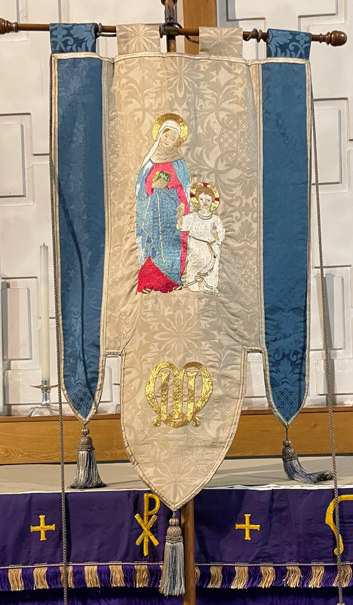
St Francis Heaton

Slide 33
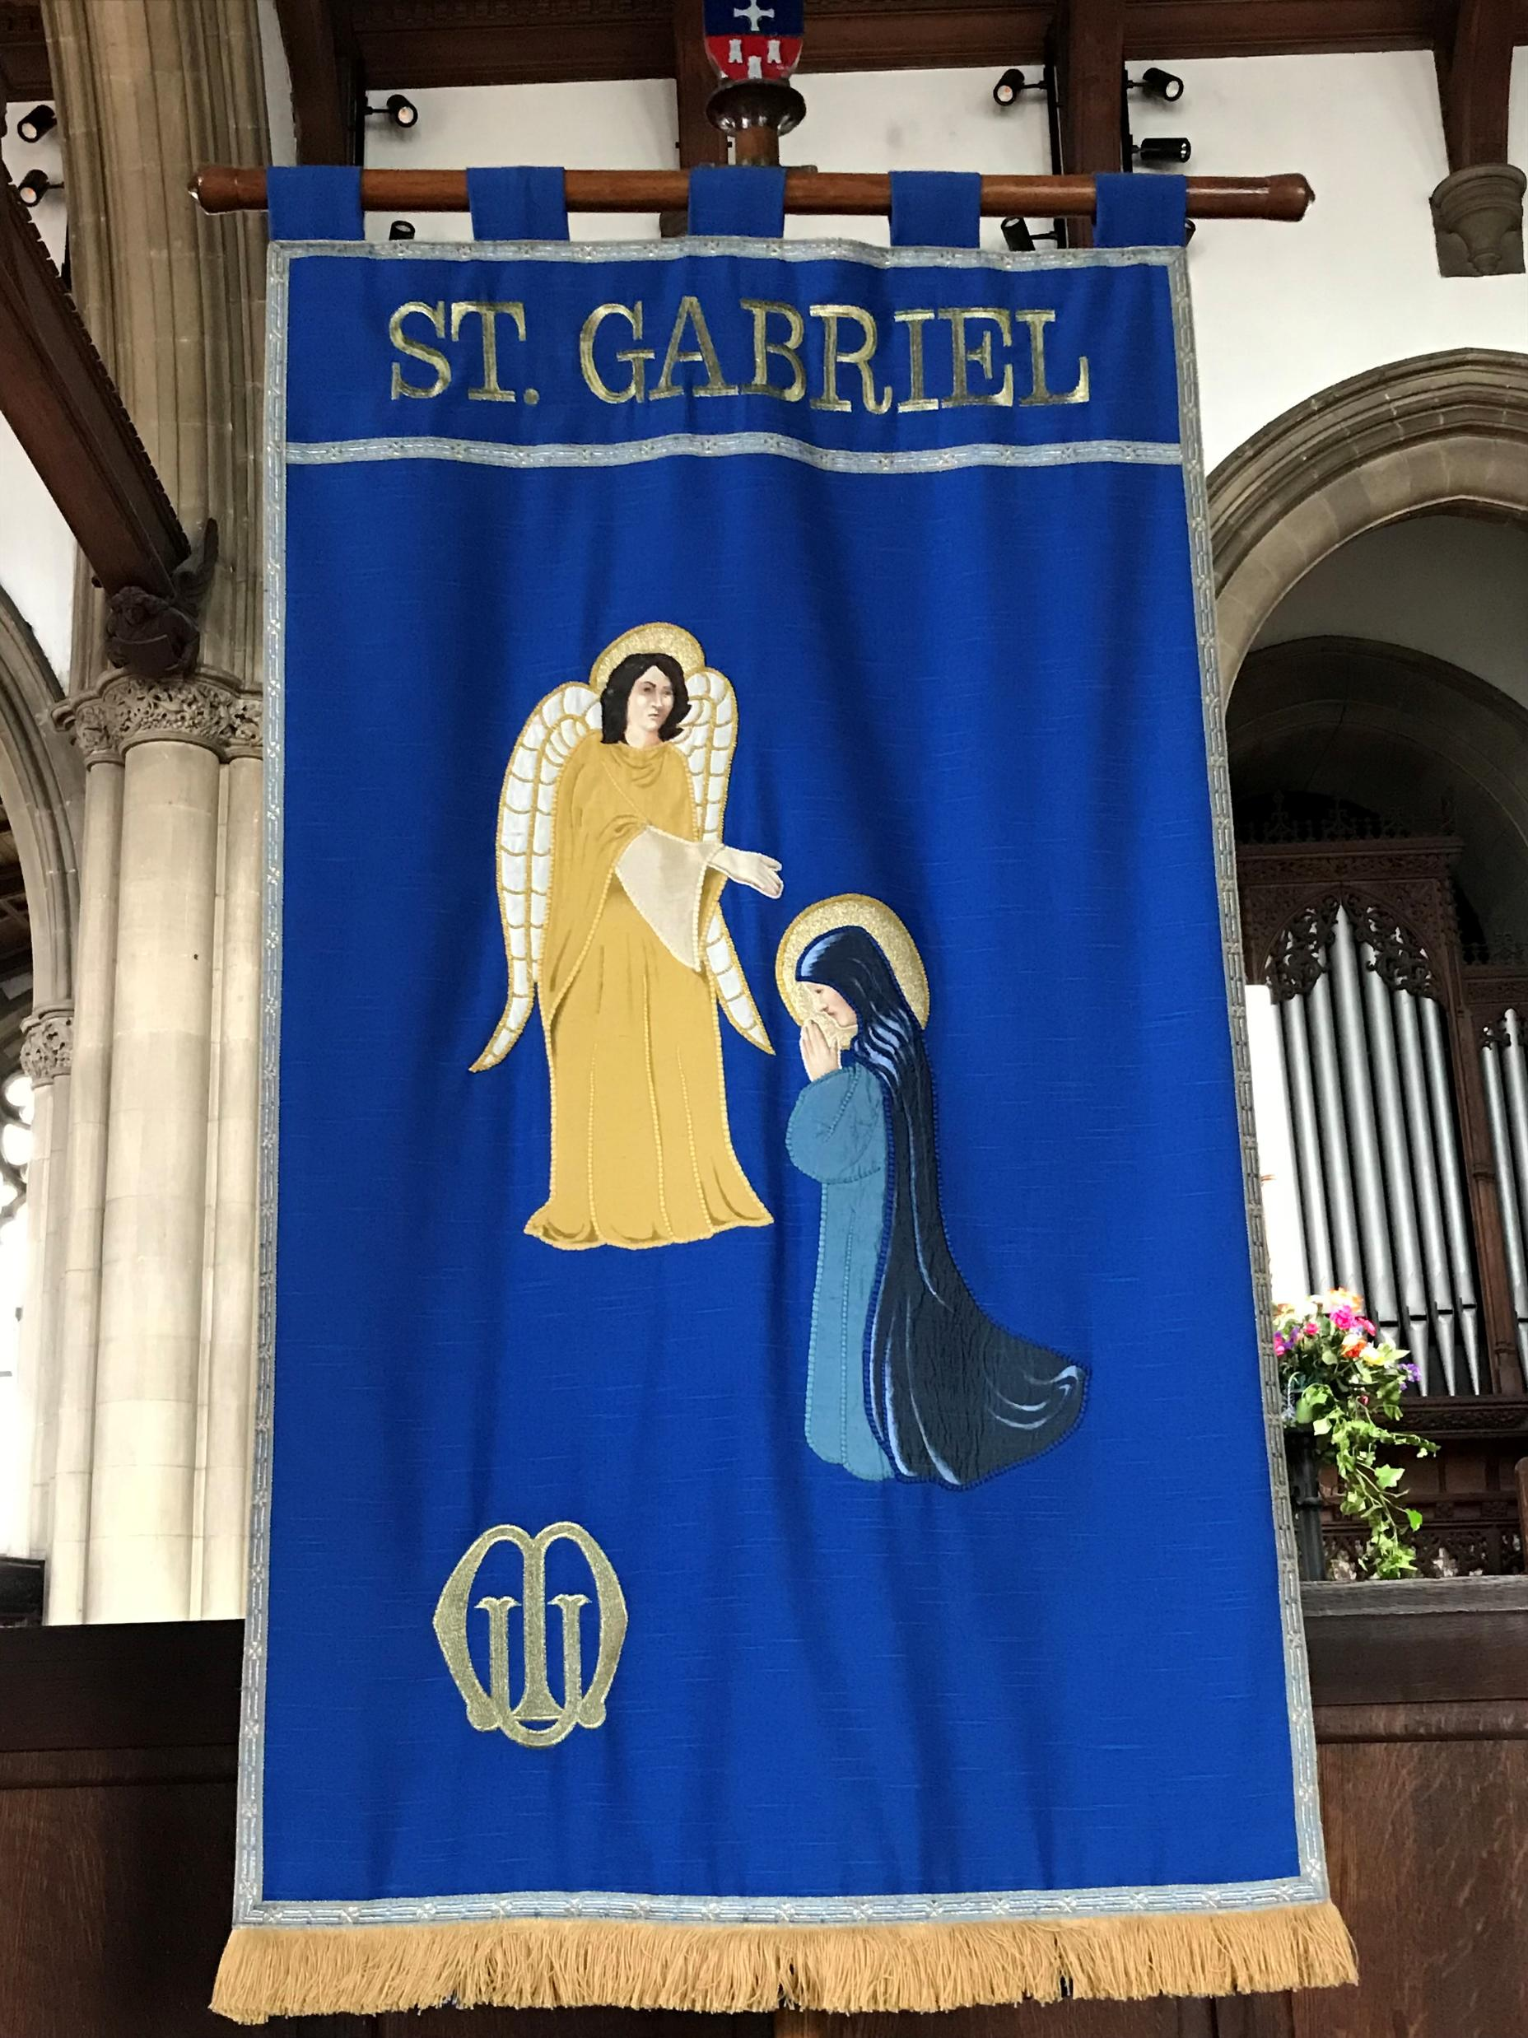
St Gabriel Heaton

Slide 34
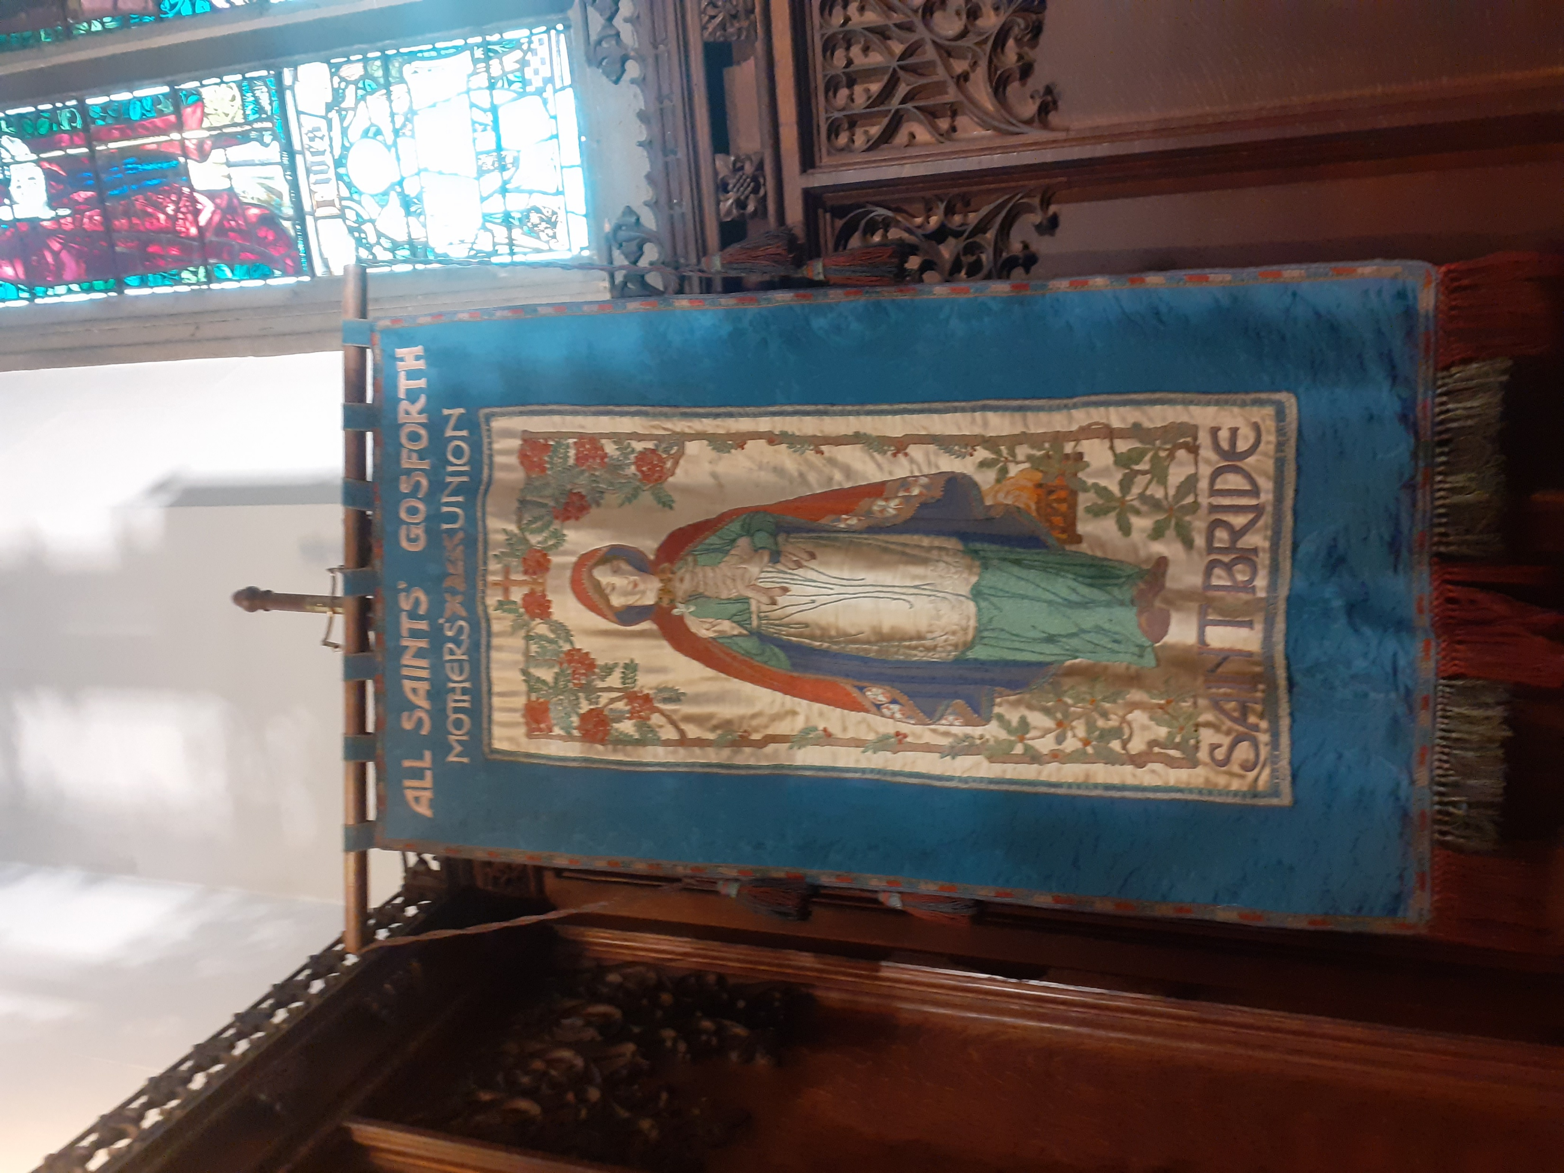
All Saints Gosforth

Slide 35
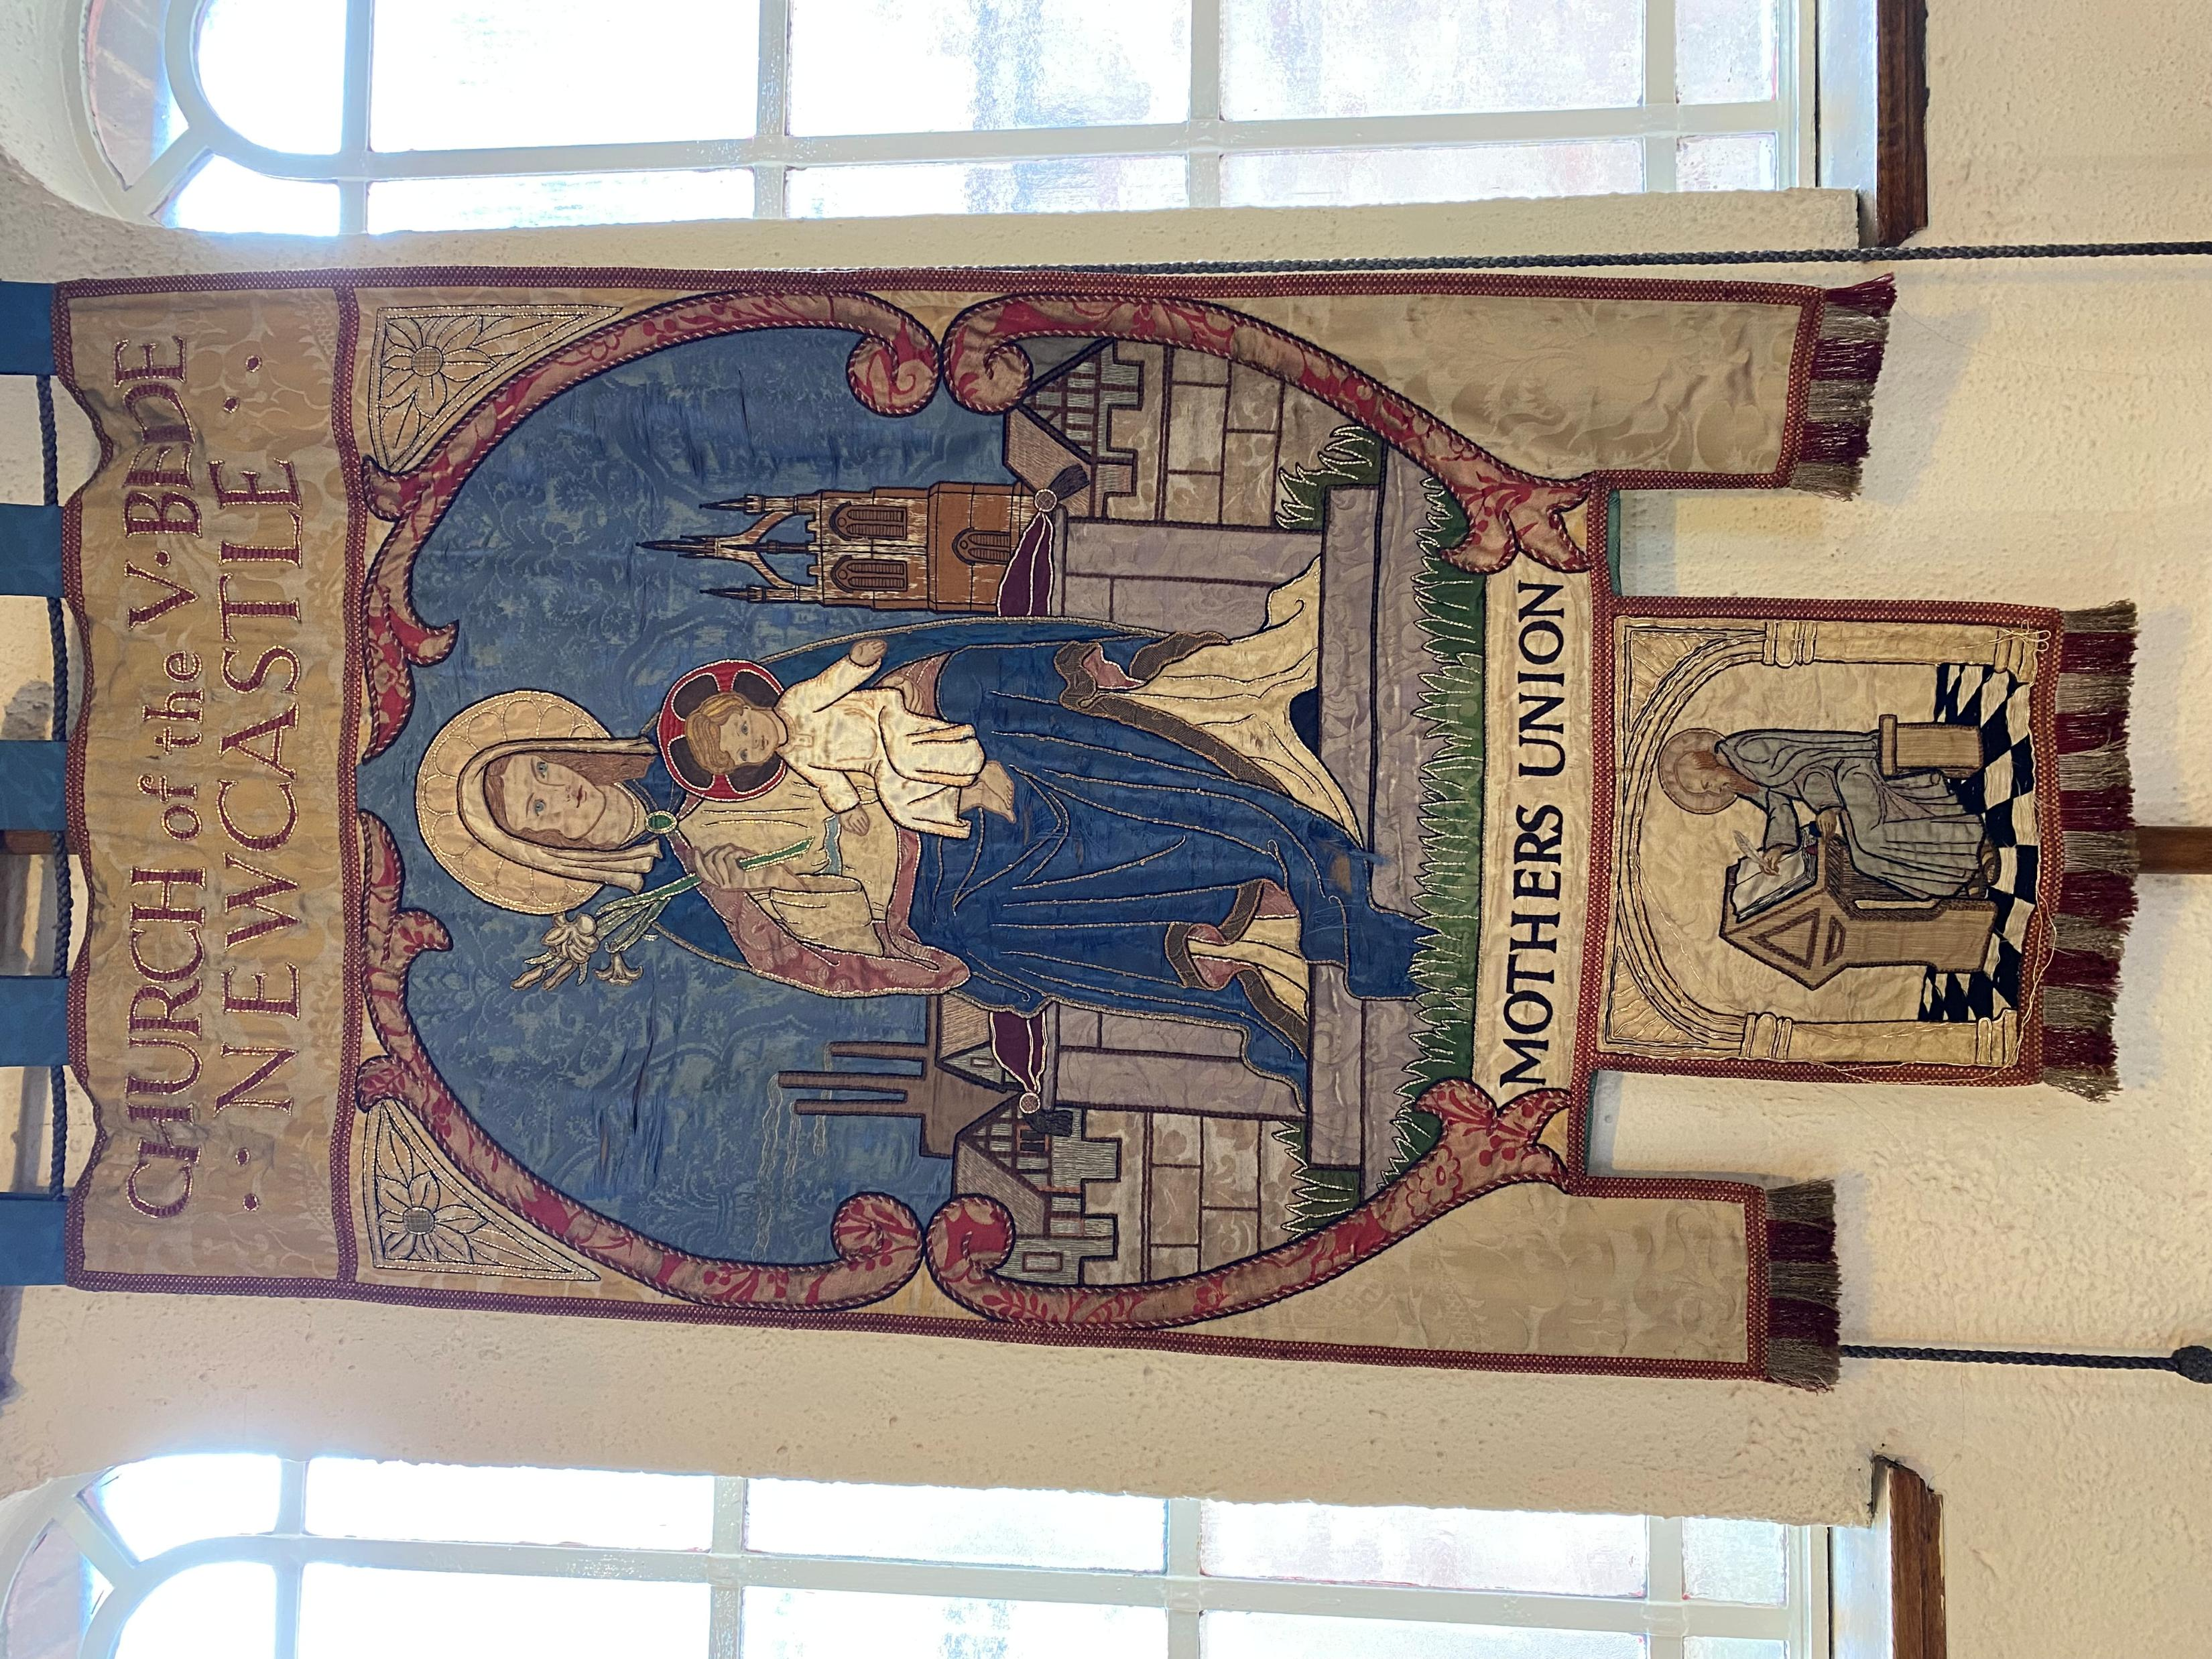
Ven Bede Benwell

Slide 36
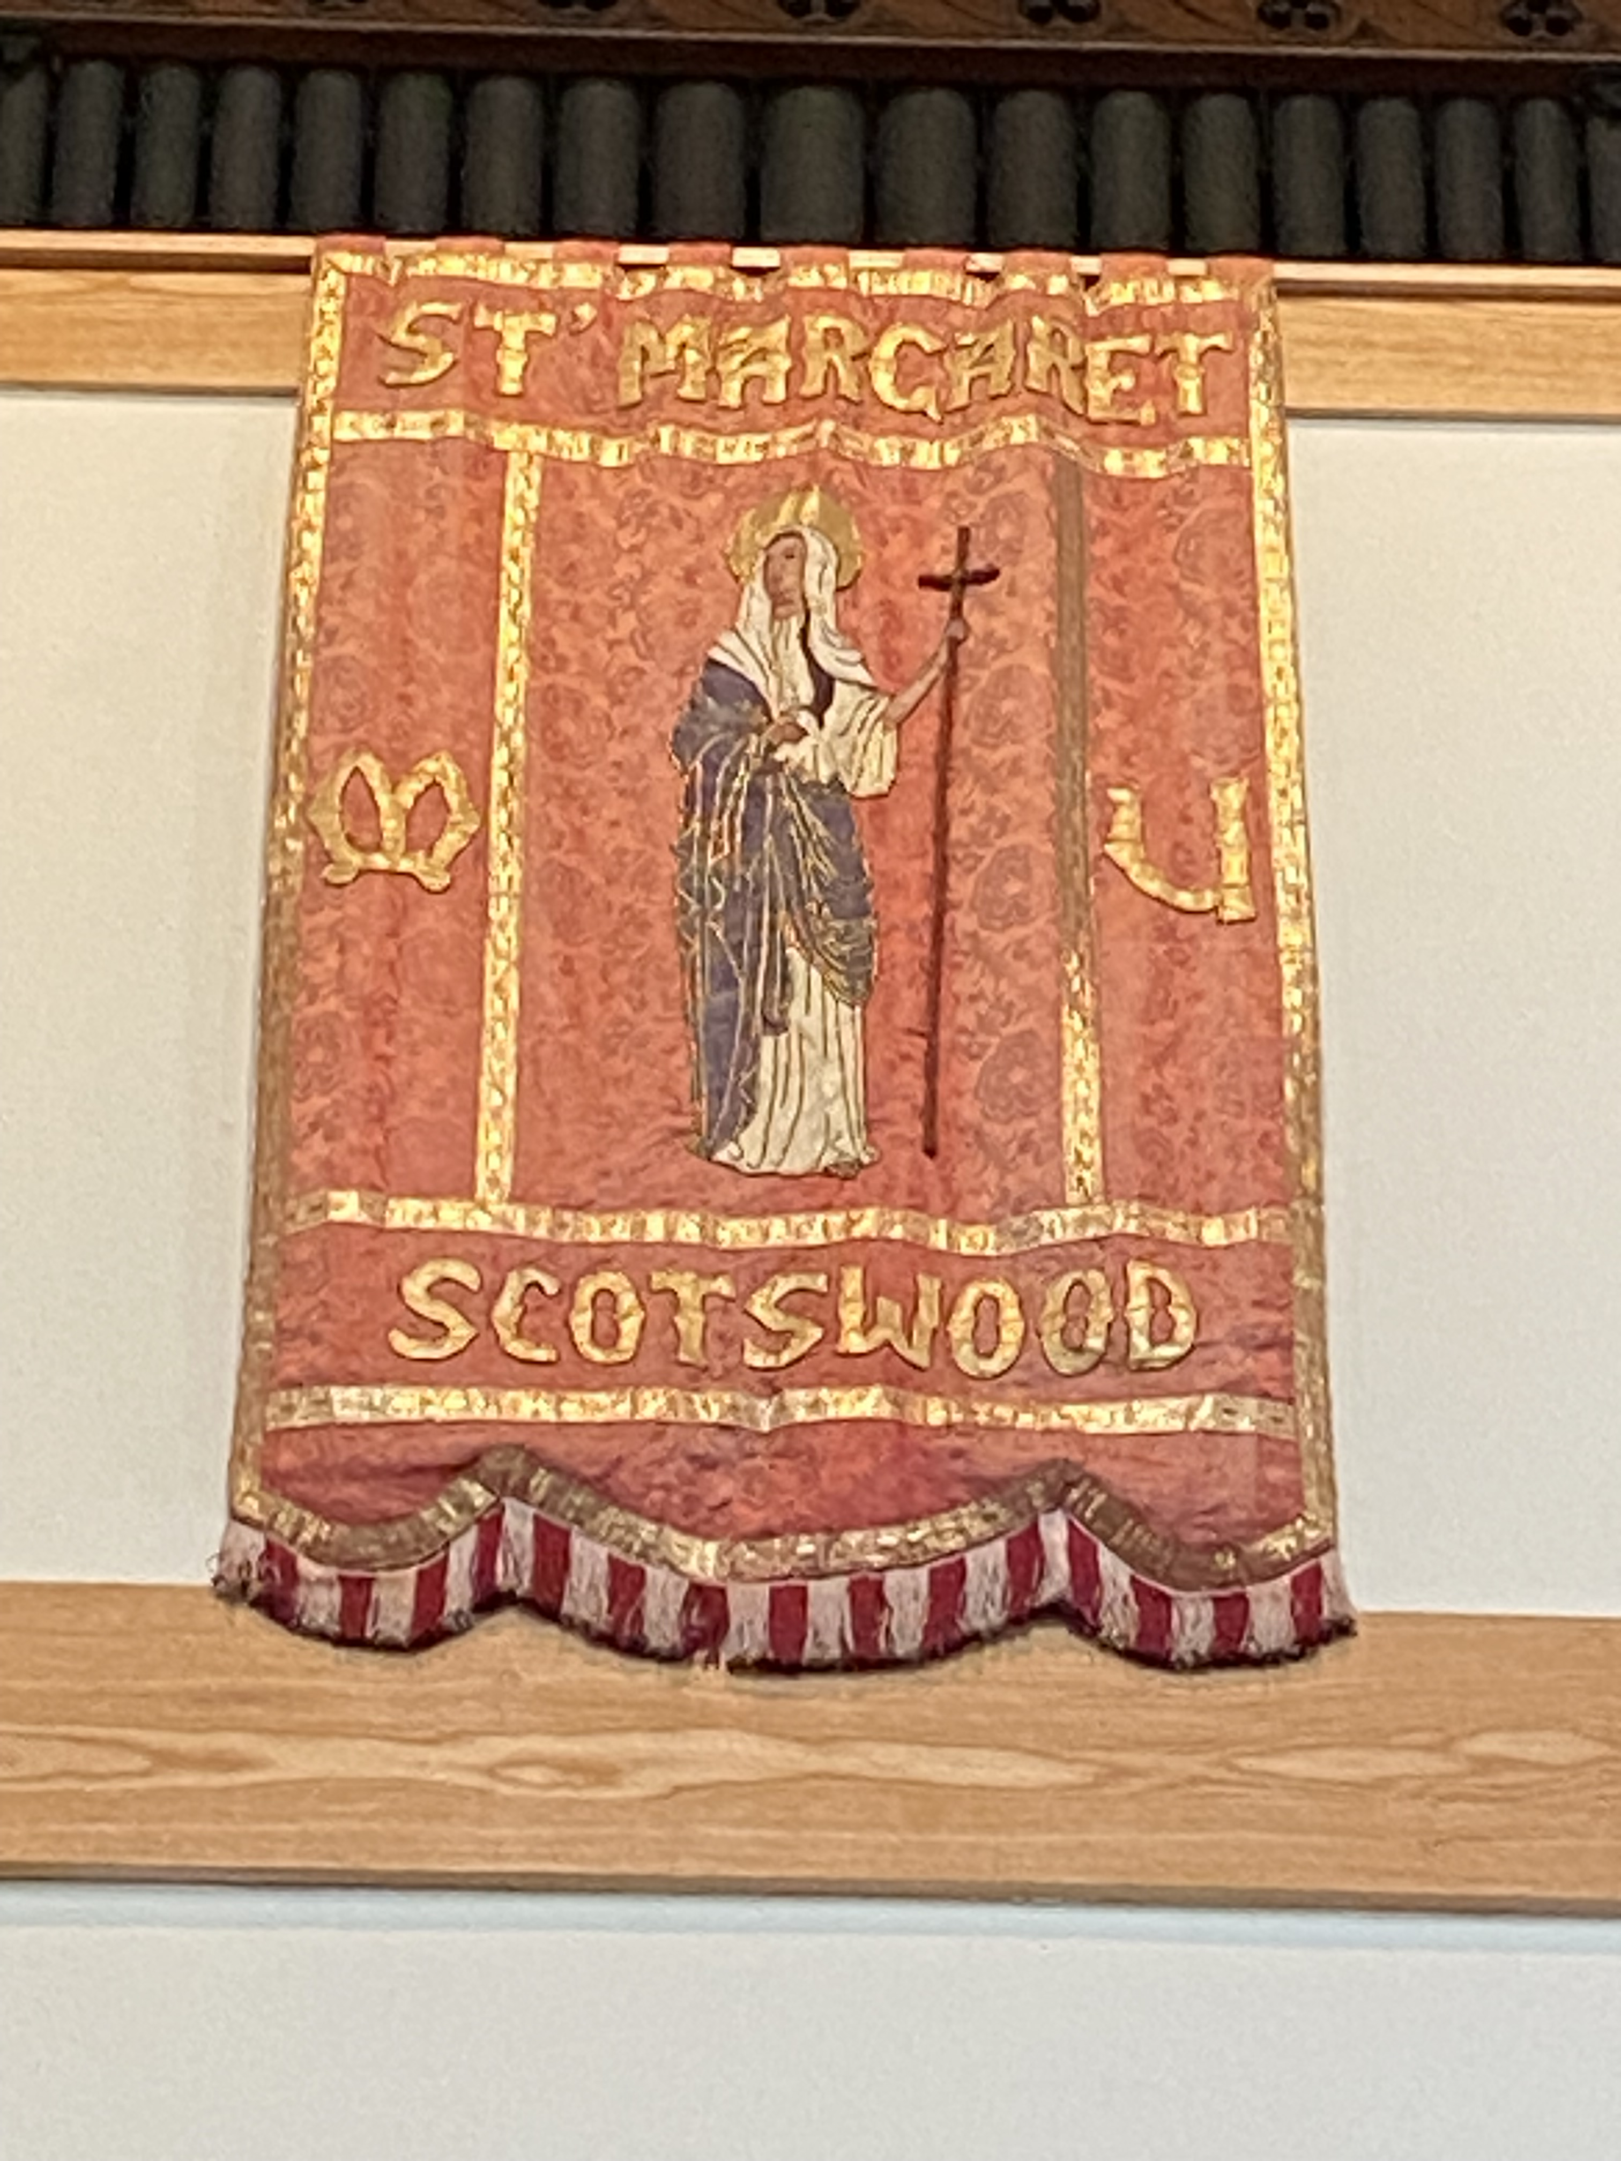
St Margaret’s Scotswood

Slide 37
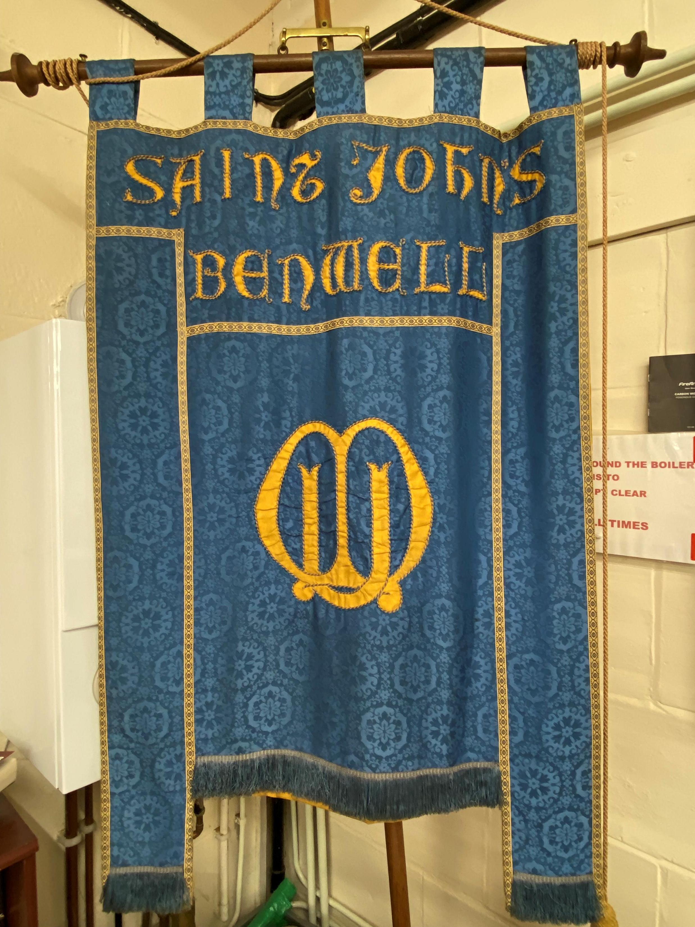
St John Benwell

Slide 38
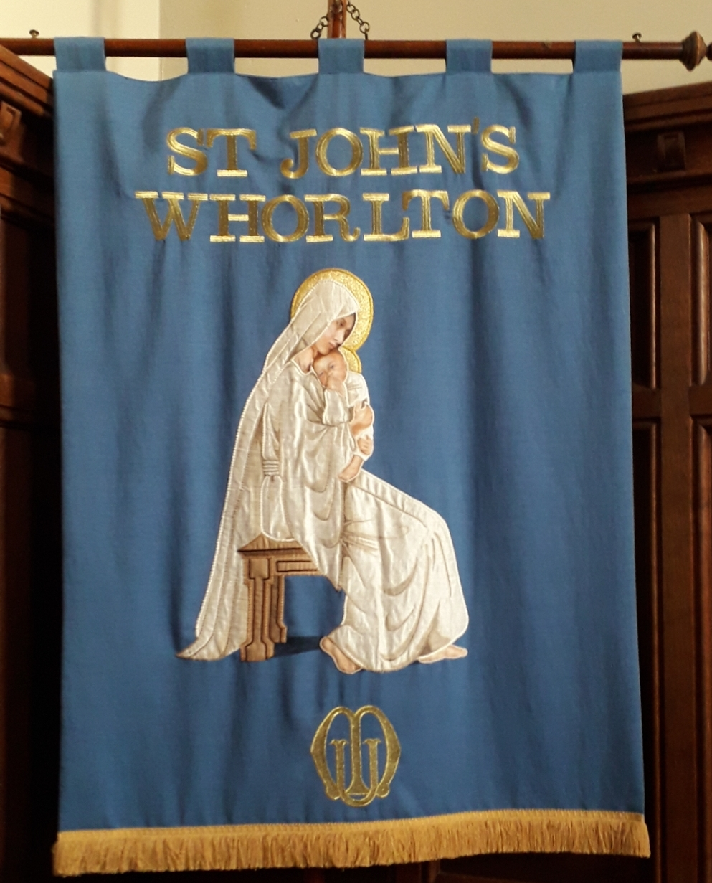
St John’s Whorlton

Slide 39
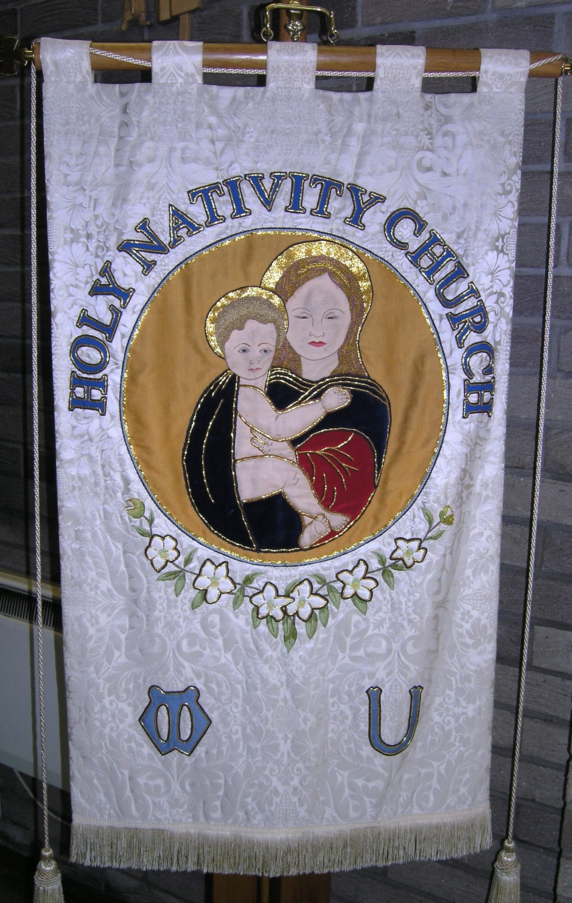
Holy Nativity
Chapel House

Slide 40
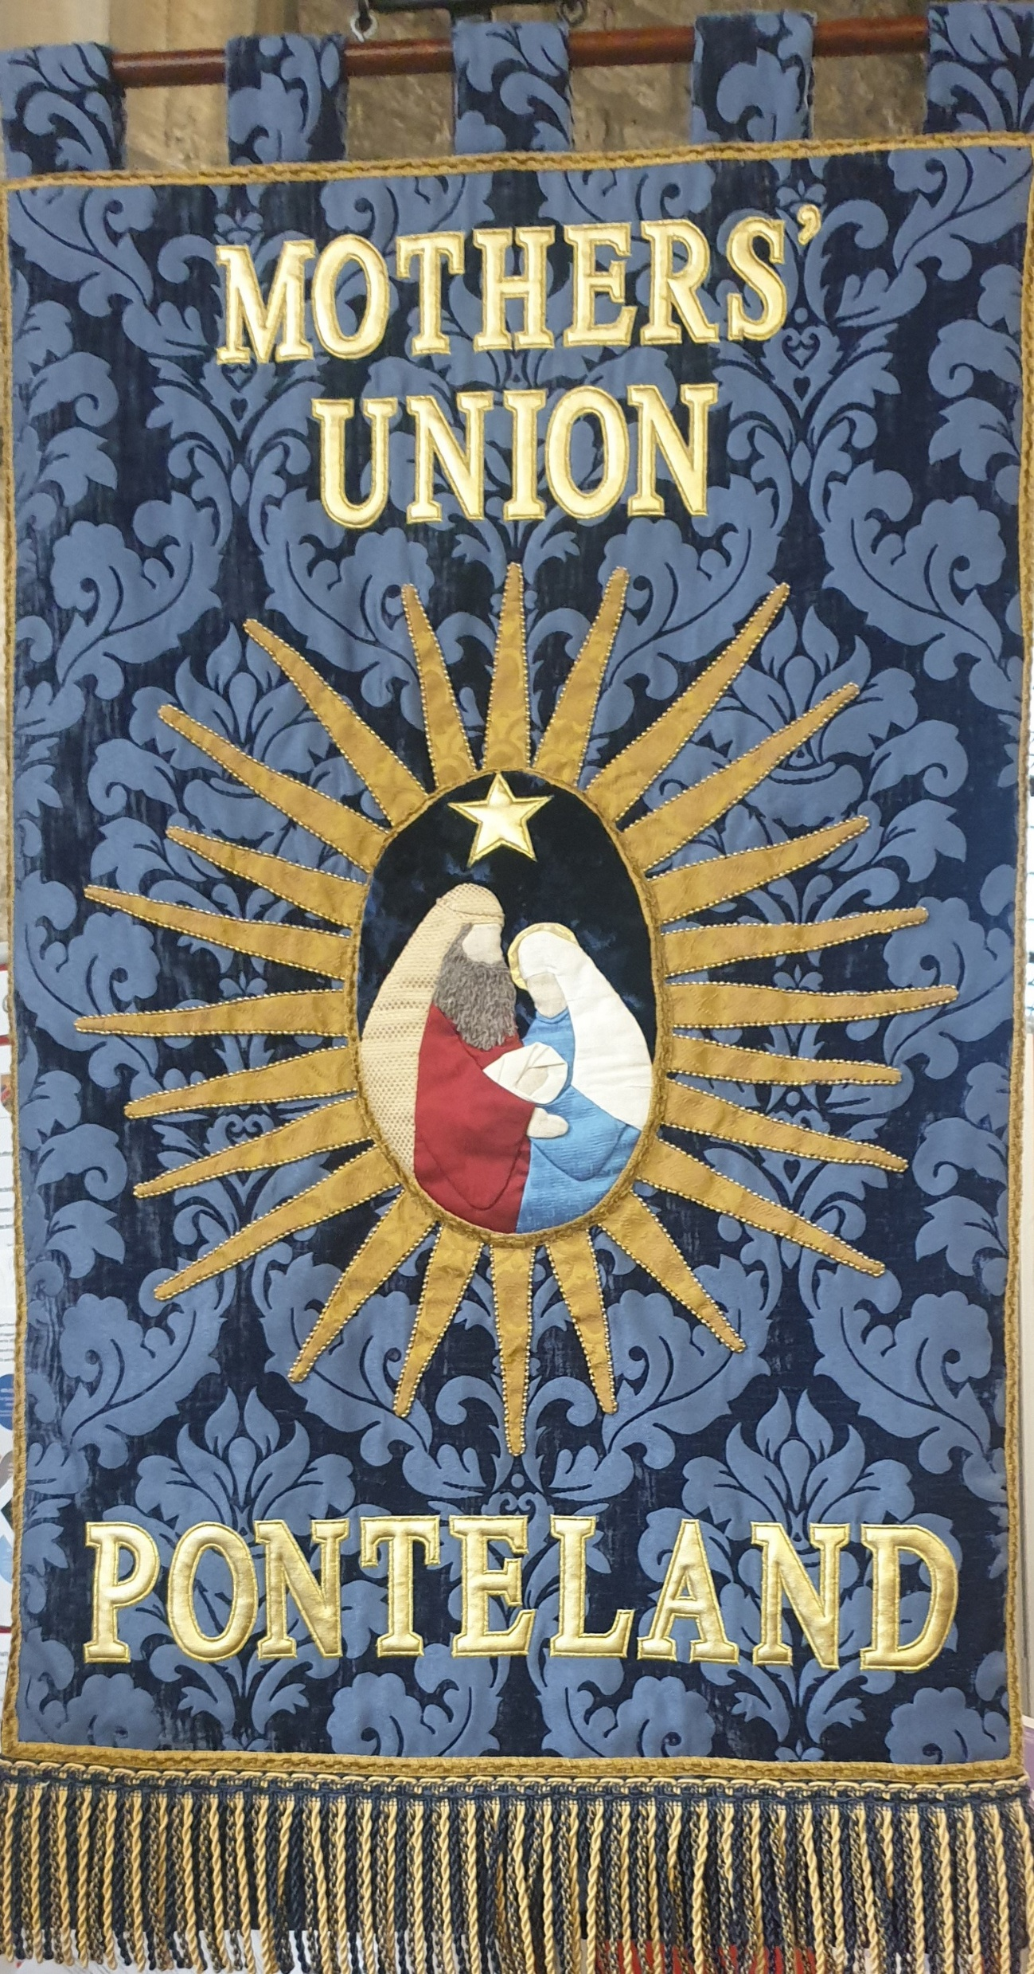
St Mary Ponteland

Slide 41
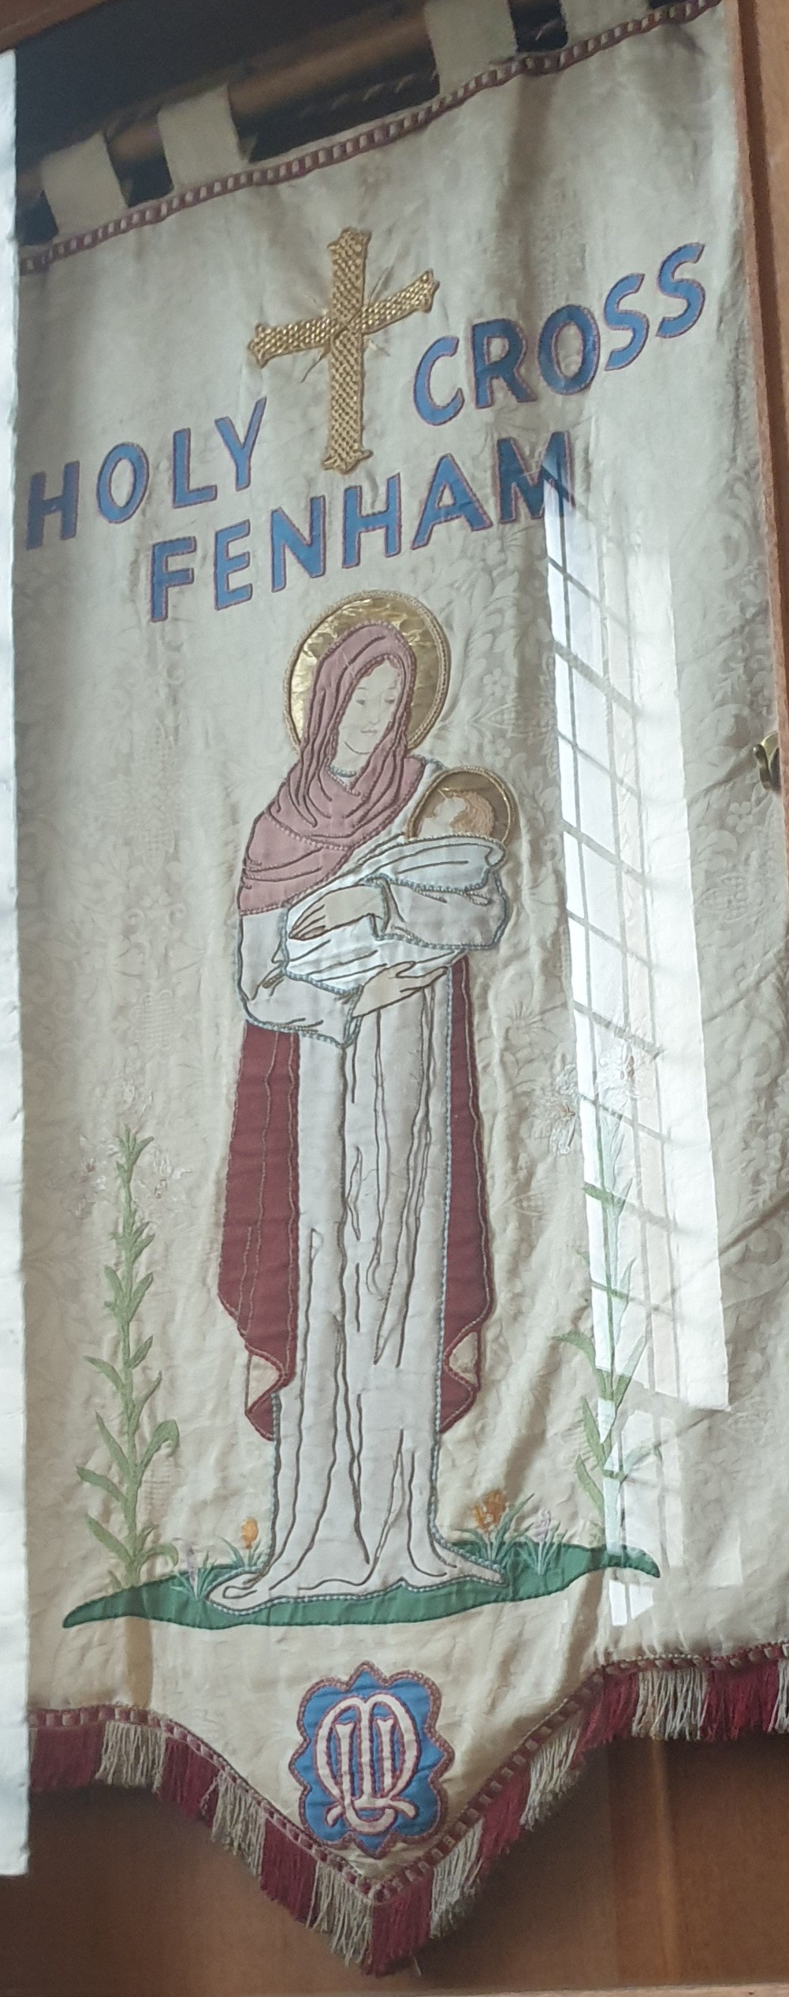
Holy Cross Fenham

Slide 42
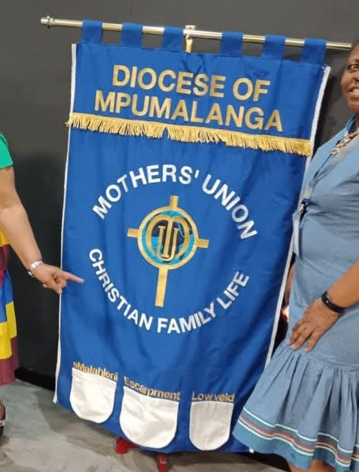
Mpumalanga -
a link diocese in South Africa

