Slide 1
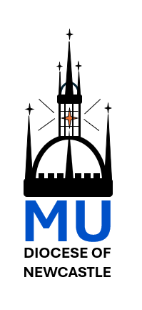


A Brief History of Mothers’ Union in Newcastle Diocese

Slide 2
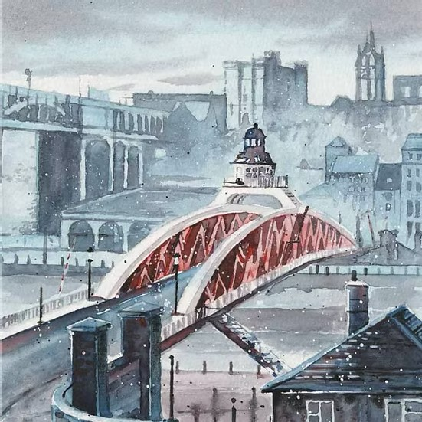
1876 – a significant year
The Swing Bridge opens: overlooked
by the Lantern Tower, a guiding light
for ships for centuries.
Mary Sumner’s 1st Mothers’ Meeting.
Parliament considers forming
a Diocese of Newcastle
Art by David Holliday, used with artist’s permission

Slide 3
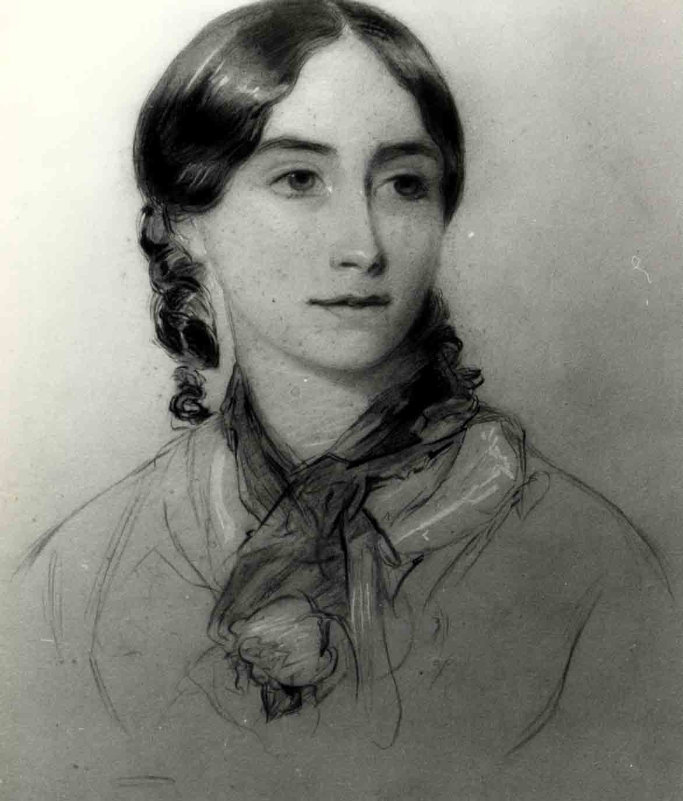
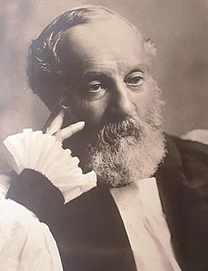
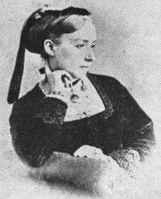
Mary Sumner 1829 – 1921 ‘Union of Mothers’ founded 1876
Revd George Sumner – Vicar of Alresford, later Bishop of Guildford

Slide 4
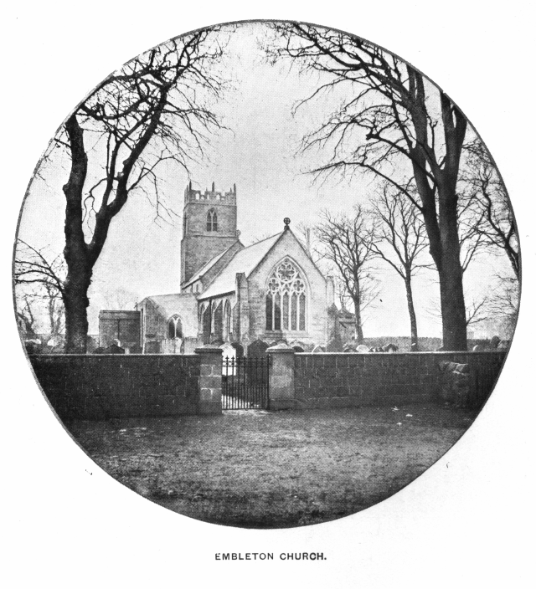
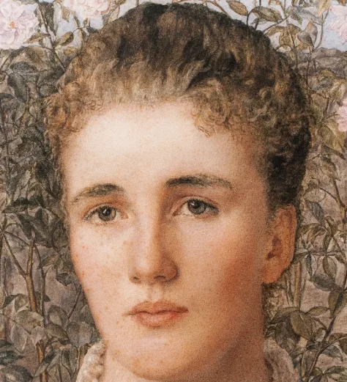
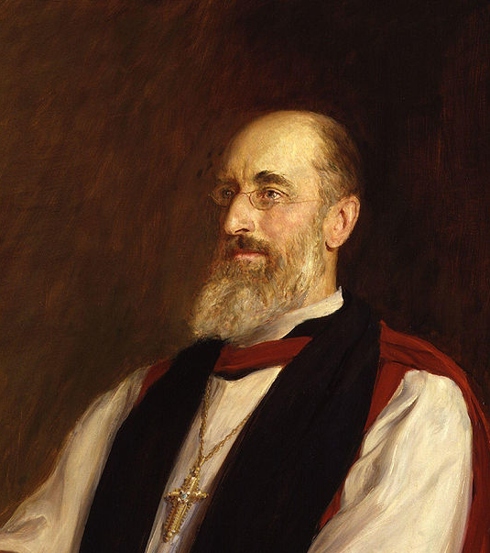
Revd. Mandell and Louise Creighton Embleton Parish 1875-1884
1879
Louise called the first Mothers’ Meeting in Northumberland
Mandell later became Bishop of London

Slide 5
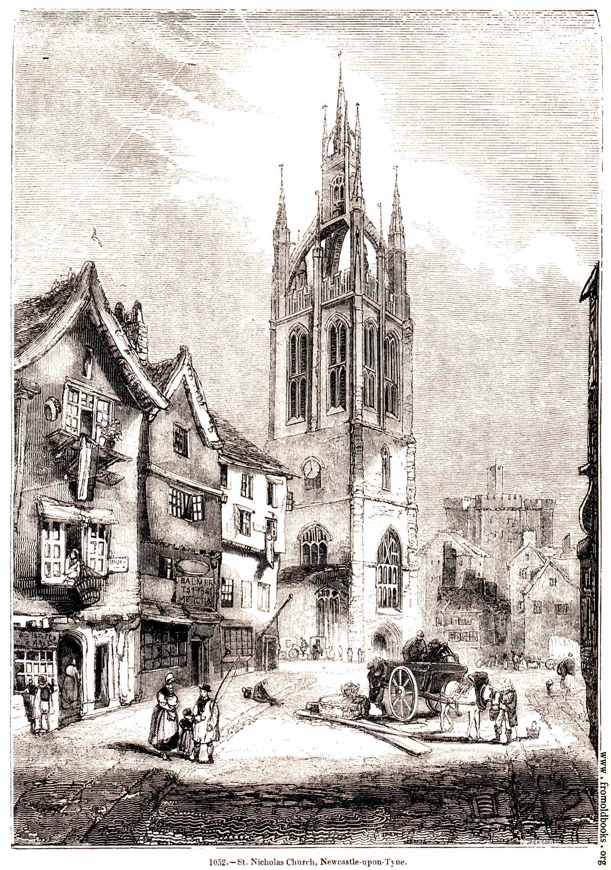
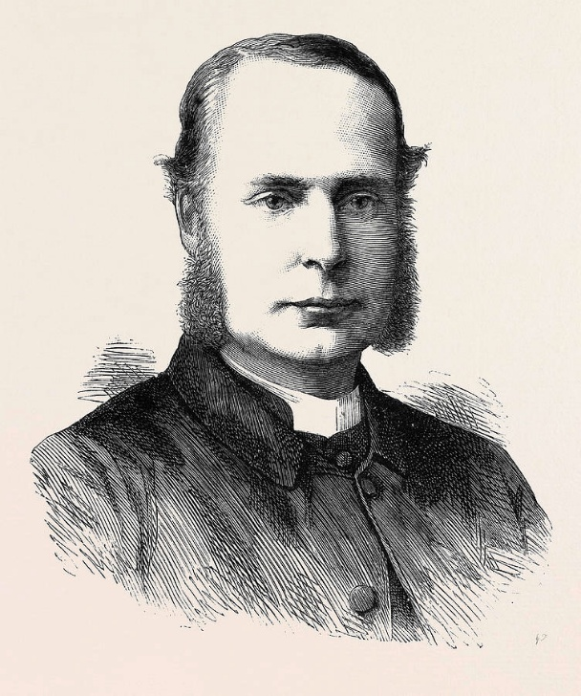
Newcastle Diocese is formed in 1882
St Nicholas Church became Newcastle Cathedral
Ernest Wilberforce appointed First Bishop of Newcastle

Slide 6
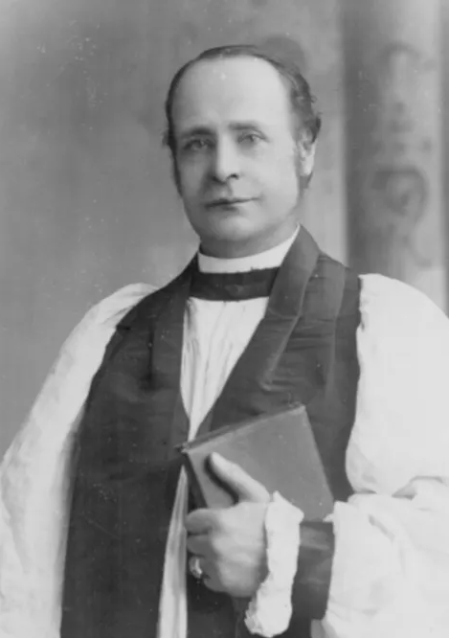
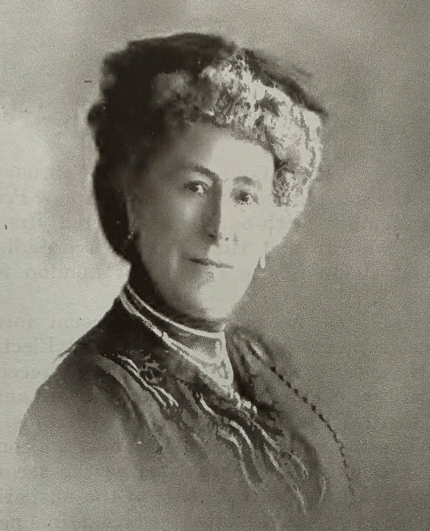
Portsmouth Congress 1885
Bishop Ernest Wilberforce of
Newcastle persuades Mary Sumner
to speak about a Union of Mothers
Emily Wilberforce becomes first
Diocesan President, later voted as
Central President
‘Those that rock the cradle rule the world’

Slide 7

Mothers’ Union - First 50 years
1900: 170,000 members in 28 Dioceses.
Campaigns for social welfare:
to stop children collecting alcohol from public houses
to raise the Age of Marriage from 12 to 16
1913 – Mary Sumner, aged 84, visited Hexham
1921 - Mary Sumner died on 11th August
1925 - Mary Sumner House opened in Westminster
1926 - MU granted a Royal Charter / 490,000 members

Slide 8



1974 MU Constitution is revised
MU now open to both women and men, married or unmarried, and no longer excluding divorcees.
2000 Mothers’ Union is given consultative status at the United Nations on poverty, gender equality and HIV / AIDS

Slide 9


Mothers’ UNION Today
Mothers’ Union has 4 million members
in 83 countries across the world
within the Anglican Communion.
Through prayer and action,
MU seeks to build healthy communities
and to campaign for justice, challenge
prejudice and advocate for change.

Slide 10
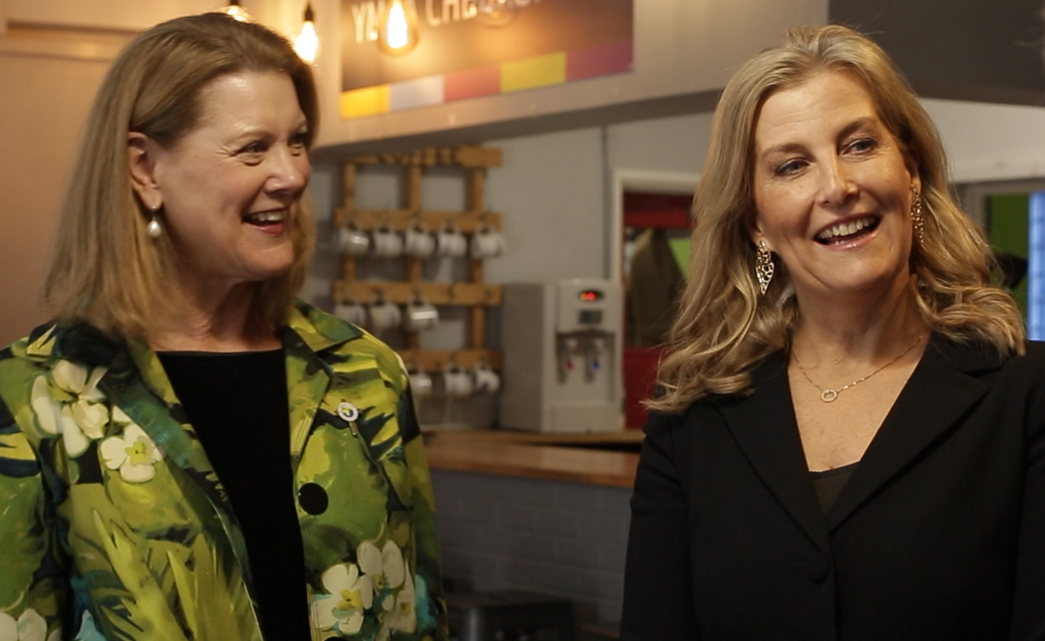

Royal Patrons of Mothers’ Union
WWP Kathleen Snow
with HRH Sophie,
Duchess of Edinburgh
Queen Victoria
HRH Princess Mary
Queen Elizabeth (Queen Mother)
Queen Elizabeth II 1952-2022
HRH Sophie, Duchess of Edinburgh 2025 -

Slide 11

Newcastle Diocese has 32 parish-based branches, a Diocesan and an Internet branch.
Branches are integral to the church’s mission and ministry both locally and globally.
They operate independently to identify local needs and offer help where support is limited.

Slide 12

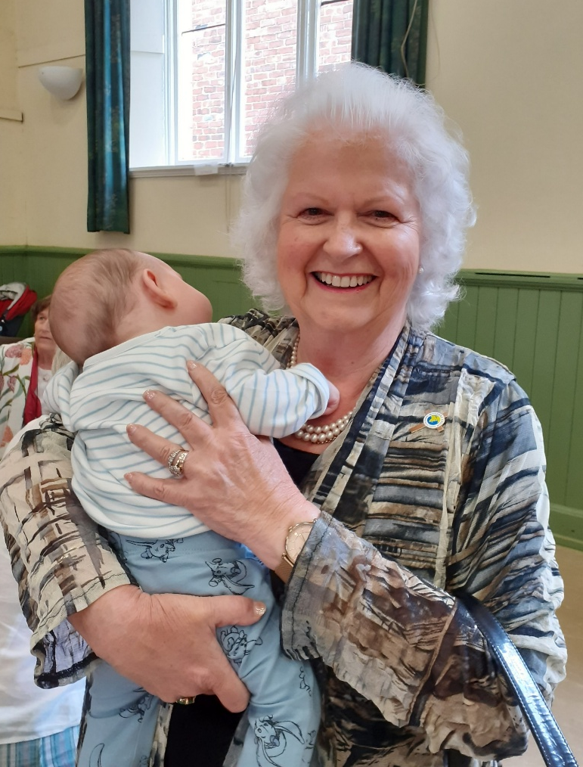
Newcastle Diocesan Presidents
1886-1896 Emily Wilberforce……..
…..Lily Dixon 1971-1974
Sheila Spriggs 1974-1980
Anne Forman 1980-1986
Doreen Richardson 1986 -1991
Dorothy Robinson 1991-1997
Helen Brunton 1998-2003
Pat Johnson 2004-2009
Jennifer Snowdon 2010-2015
Barbara Packer 2016-2021
Margy Tasker-Brown 2022-

Slide 13
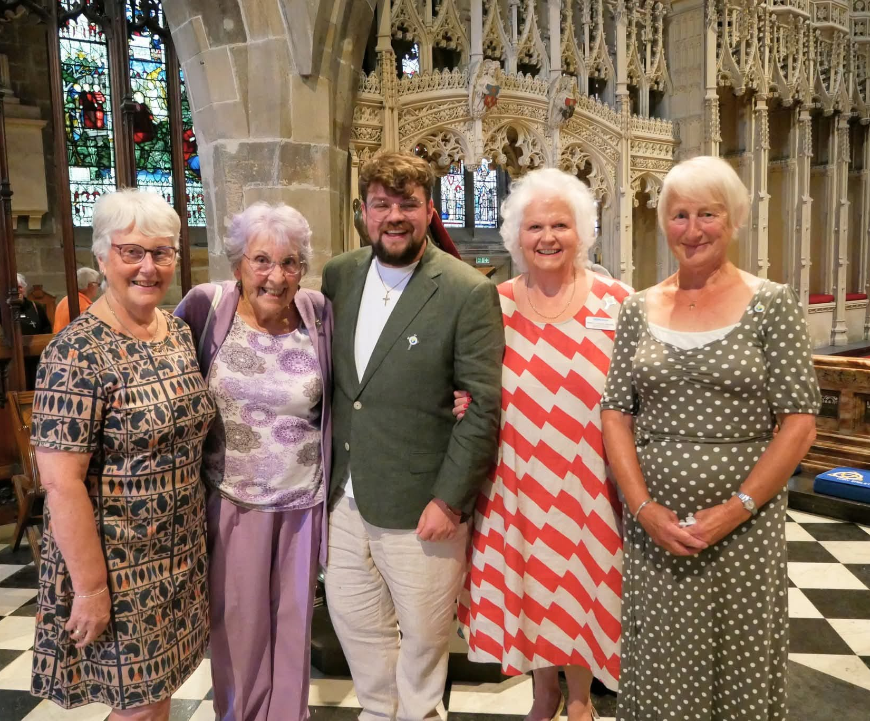
Join Us, Join In We are Stronger Together
MU is integral to the mission
and ministry of the church
Join Us, Join In!
and become part of a community
actively living out Christ’s call
to justice, peace, and love.
We love to welcome new members,
like Anthony…
What about you?

Slide 14

Mary Sumner’ s Prayer
All this day, O Lord,
let me touch as many lives as possible for thee;
and every life I touch,
do thou by thy Spirit quicken,
whether through the word I speak,
the prayer I breathe,
or the life I live.
Amen

